Slide 1
How to stay Safe and Healthy at school during the Coronavirus
For reception and Year one pupils

Slide 2
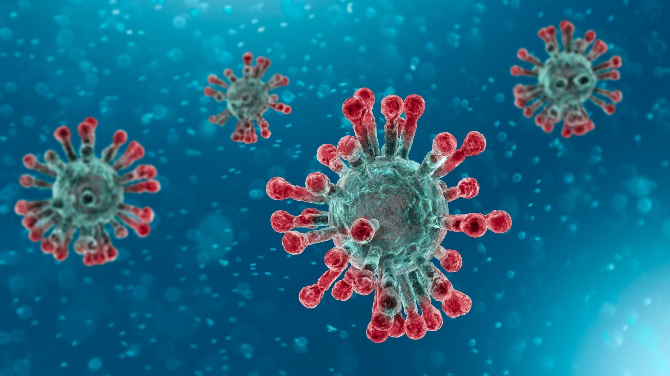
So what is Coronavirus?
Coronavirus is an illness that affects people’s breathing and lungs.
It can be spread from person to person by coughing or by touching surfaces or areas of skin that have been contaminated by the virus.
That’s why it is so important to…
WASH OUR HANDS ☺

Slide 3
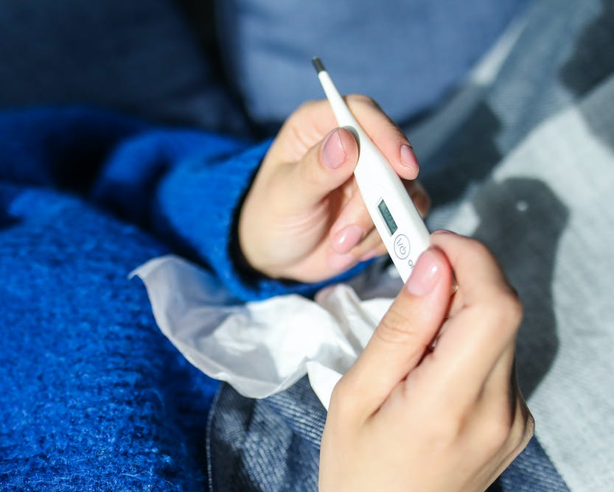
Symptoms to look out for.
The most important symptoms of coronavirus (COVID-19) are:
a new continuous cough
a high temperature
a loss of, or change in, your normal sense of taste or smell
If you don’t feel well, it’s very important that you tell an adult.
Notes:
Explain that if they feel any of these symptoms then to tell an adult that is with them.
We are now going to talk about things you can do at School to keep yourself healthy and safe.

Slide 4
Now that it is safe for you to come back to school, here is what you can do to take care of yourself and others:
https://www.youtube.com/watch?v=dnQKQgIaBug&feature=youtu.be

Slide 5
Let’s talk about what happened to us...
Notes:
Brief explanation of COVID-19 and why we went into Lockdown.
Example:
All of you will know that many parts of the world went into lockdown in March when we were all sent home to stay in because of a new virus that was making people unwell. Can you remember what it’s called?
Do you know what a virus is?
A virus is a tiny germ, way smaller than anything you can see. Viruses can make us sick, but they can't do anything on their own — they need to live inside another creature for example us, to survive. To help stop them we must stay away from anyone that is poorly and remember to wash our hands really well.
We will talk more about how to wash our hands later.
Questions? Thoughts and Feelings?
Encourage the children to share their experiences.

Slide 6
Keeping Active
Notes:
Explain that it is important to keep active everyday. We need to keep our bodies healthy and strong to be able to do lots of fun things.
What ideas can the children come up with to stay active?

Slide 7
Keeping at a distance

Slide 8
Behaviour

Slide 9
Washing your hands
https://www.youtube.com/watch?v=FqaXBtSaiUE
Notes:
Explanation of the importance of washing their hands and how to do it. Also ask when do they think they should wash them
You should wash your hands for the amount of time it takes to sing "Happy Birthday" twice (around 20 seconds)
https://www.youtube.com/watch?v=S9VjeIWLnEg

Slide 10
Notes:
This is a visual guide on how to use hand gel. Ask the children to practice the steps with you.
You can obtain the printable version on:
https://www.who.int/gpsc/5may/How_To_HandRub_Poster.pdf
We recommend to have this visual guidance in restrooms and classrooms.

Slide 11
Notes:
This is a visual guide to help children learn about the ‘Catch It Bin It Kill It’ campaign. If a tissue is not at hand, advise children to cough into their elbow/shoulder to avoid germs getting onto their hands.
Advise children to do not touch their eyes, nose or mouth if their hands are not clean

Slide 12
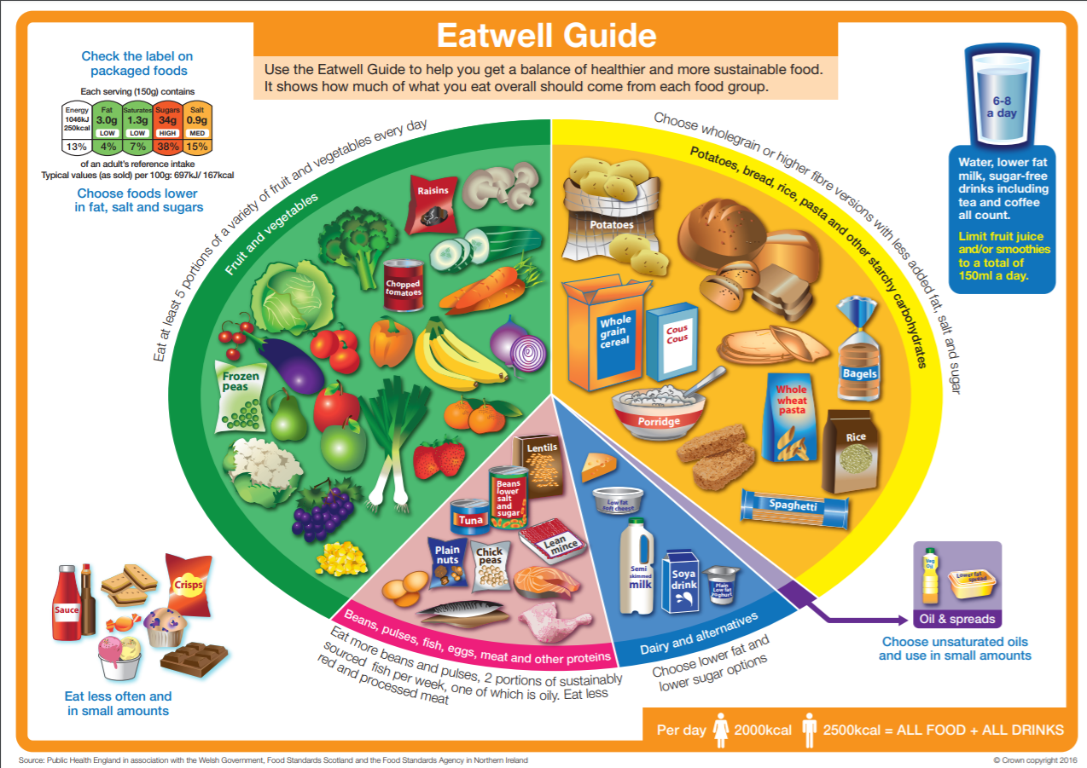
Eating a Healthy Balanced Diet can help strengthen our Immune System
Notes:
Go through each section of the eat well guide and discuss the importance of having a balanced diet with nutritious fruit and veg.
Fruit and veg have immune boosting properties which can fight off infections.

Slide 13
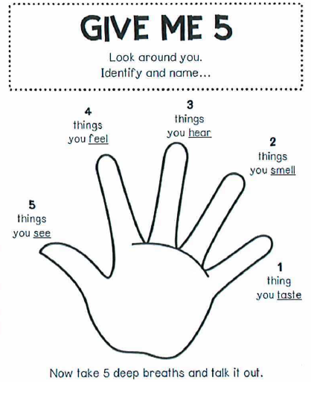
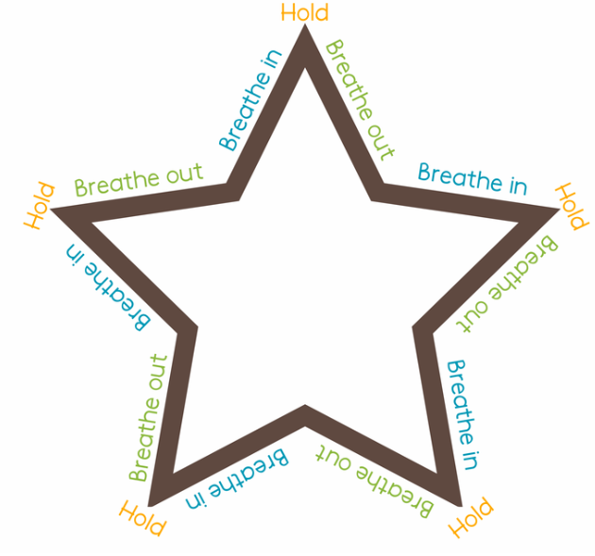
All Feelings Are Normal
We understand that coming back to School may cause a range of different feelings, but all these feelings are normal!
If you have any sad or worry feelings, that’s ok ☺ It really helps to talk about these feelings to an adult you trust.
Notes:
Following this pandemic, children may show signs of feeling worried about going back to school or be fearful that they may catch the virus. Reassure the children that all these feelings are normal and as long as we wash our hands and stay a safe distance apart that we are doing everything we can to stay healthy.
The Give me 5 hand is a mindfulness grounding technique which helps overwhelming feelings. Use this time to demonstrate with the group if they are engaged.
Ask the children to identify the different emotions that the emojis are expressing.
The star is a breathing technique in which they will follow round the star, breathing in and out slowly. This can also help with anxious feelings.

Slide 14
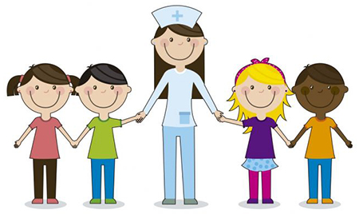
School Nurses are here to help
The School Nursing Team ensure that children and young people living in Southend are happy and healthy.
If you have any health worries, we can help you.
If you’re in Primary School, your parent or carer can call us on
01702 534843 or Text on 07507 331884.

Slide 15
Keep yourself safe and have fun!
Notes:
This can be a time to discuss any questions after watching the slides and to reiterate the need for social distancing as much as possible.

Slide 16
References
Author Julia Donaldson’s (2020)
https://www.booktrust.org.uk/news-and-features/features/2020/april/the-gruffalo-stick-man-and-the-smartest-giant-in-town-lend-a-paw-a-stick-and-a-hand-to-help-with-the-coronavirus-effort/
World Health Organisation:
https://www.who.int/gpsc/5may/How_To_HandRub_Poster.pdf
NHS Choices:
https://www.nhs.uk/conditions/coronavirus-covid-19/check-if-you-have-coronavirus-symptoms/
https://www.nhs.uk/live-well/healthy-body/best-way-to-wash-your-hands/
https://www.nhs.uk/live-well/eat-well/the-eatwell-guide/

