Slide 1
How to stay Safe and Healthy at school during the Coronavirus
For year 6 pupils
Notes:
Click the Link for Welcome Back to School and Nursery Video

Slide 2
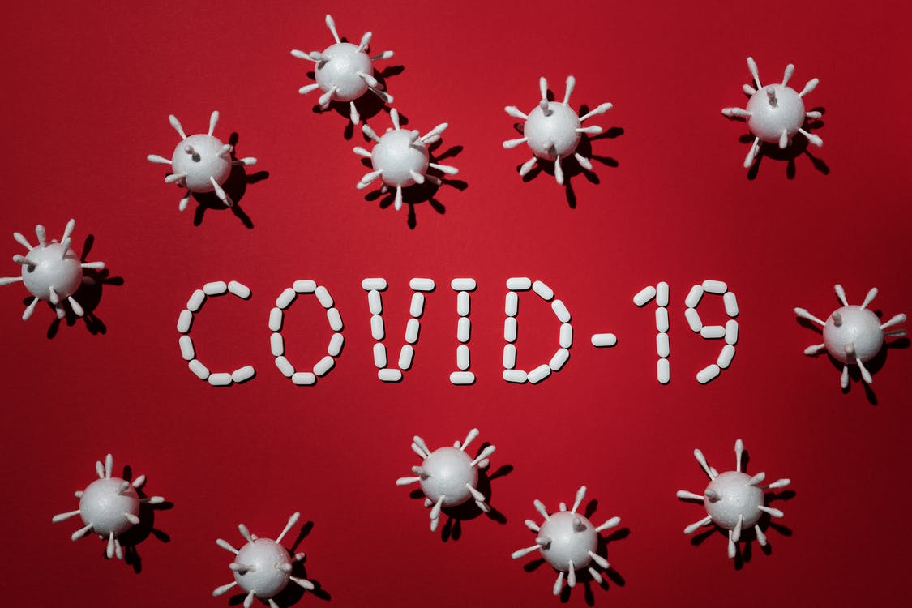
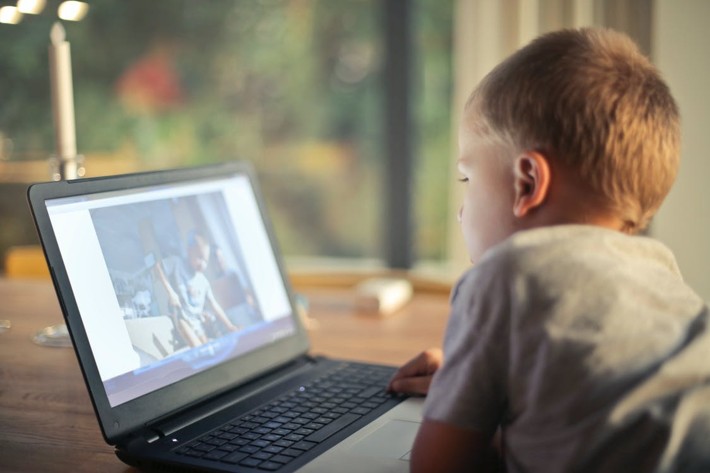
Let’s talk about what happened to us ...
Lockdown started on 23rd March
Reception, Year 1 and Year 6 started to go back to School on 1st June.
Notes:
Brief explanation of COVID-19 and why we went into Lockdown.
Example:
All of you will know that many parts of the world went into lockdown in March because of a new virus that were making people unwell. Scientists named this virus COVID-19 or commonly known as Coronavirus.
Viruses are invisible so it is hard to know where the virus is spreading to.
To avoid many more people getting unwell, the UK government told everyone to Stay at Home, Protect the NHS and Save Lives.
The risk of infection has lowered because of the lockdown, so the UK Government advised Schools to start the phase of re-opening on June 1st.
We have now been told to Stay Alert, Control the Virus and Save Lives.
We are now going to talk about things you can do at School to keep yourself healthy and safe.
Introduce a discussion with the class
Questions? Thoughts and Feelings?
What did you get up to whilst in Lockdown?
Share your Lockdown story with the class.

Slide 3
So what is Coronavirus?
Coronavirus is an illness that affects people’s breathing and lungs.
It can be spread from person to person by coughing or by touching surfaces or areas of skin that have been contaminated by the virus.
That’s why it is so important to…
WASH OUR HANDS ☺

Slide 4
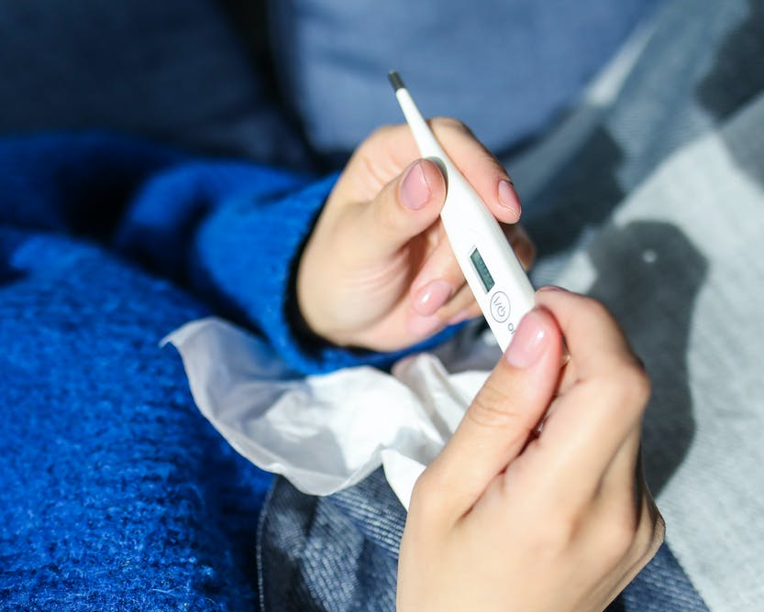
Symptoms to look out for.
Now that you’re back at school, its important that you know the symptoms and what to do when you’re feeling unwell.
The most important symptoms of coronavirus (COVID-19) are:
a new continuous cough
a high temperature
a loss of, or change in, your normal sense of taste or smell
If you feel any of these symptoms, you will need to let an adult know at the school so they can contact your parent/carer to pick you up so you can go home.
To reduce the risk of spreading the virus, you will go into a small quiet room away from other teachers and pupils. Don’t worry, this is just to keep everyone safe ☺
If you don’t have any of these symptoms, but still feel unwell, make sure you tell an adult.

Slide 5
Now that it is safe for you to come back to school, here is what you can do to take care of yourself and others:
https://www.youtube.com/watch?v=dnQKQgIaBug&feature=youtu.be

Slide 6
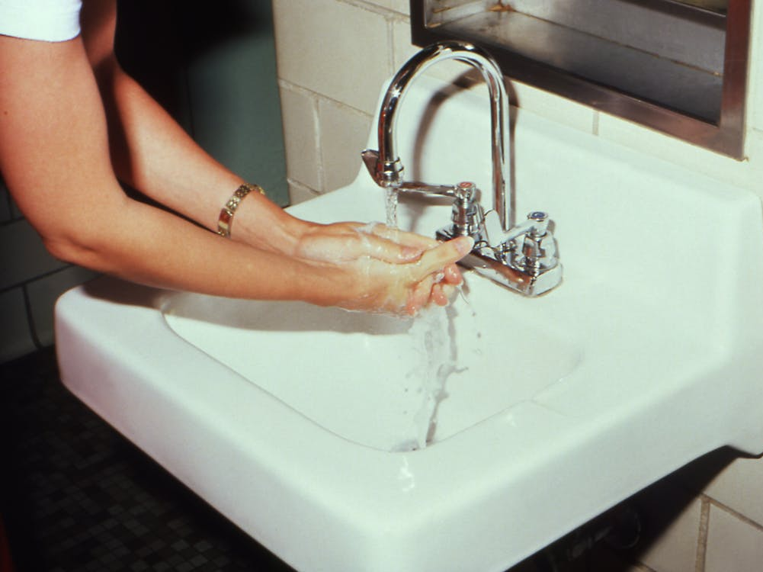
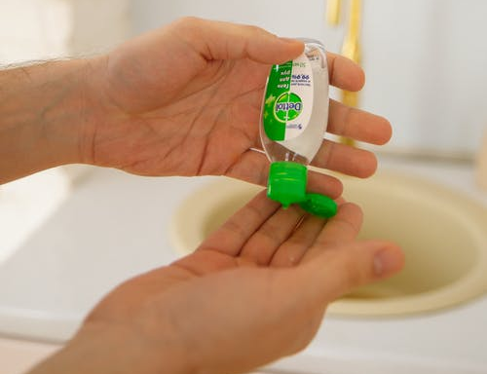
Hand Washing
https://www.youtube.com/watch?v=aGJNspLRdrc
Wet Hands with Water
Apply enough soap to cover your hands
Rub your hands together
Use one hand to rub the back of the other hand and clean in between the fingers. Do the same with the other hand.
Rub your hands together and clean in between your fingers
Rub the back of your fingers against your palm
Rub your thumb using your other hand. Do the same with the other thumb.
Rub the tips of your fingers in the palm of your hand. Do the same with the other hand.
Rinse your hands with water.
Dry your hands completely with a disposable towel.
Use the towel to turn off the tap.
Notes:
The website at the top of the page takes you to an NHS youtube video on how to wash your hands. The video plays the ‘Happy Birthday’ tune which is the same as 20 seconds.
We recommend to go through each stage of the hand washing guide by pretending to wash your hands with the class.
Handwashing Advice obtained from NHS Online.
https://www.nhs.uk/live-well/healthy-body/best-way-to-wash-your-hands/

Slide 7
Notes:
This is a visual guide on how to use hand gel.
You can obtain the printable version on:
https://www.who.int/gpsc/5may/How_To_HandRub_Poster.pdf
We recommend to have this visual guidance in restrooms and classrooms.

Slide 8
Notes:
This is a visual guide to help children learn about the ‘Catch It Bin It Kill It’ campaign. If a tissue is not at hand, advise children to cough into their elbow/shoulder to avoid germs getting onto their hands.
Advise children to do not touch their eyes, nose or mouth if their hands are not clean
https://www.nhs.uk/conditions/coronavirus-covid-19/staying-at-home-to-avoid-getting-coronavirus/staying-at-home-and-away-from-other-people/ - Advice re Social Distancing and How to Stop the Infection Spreading

Slide 9
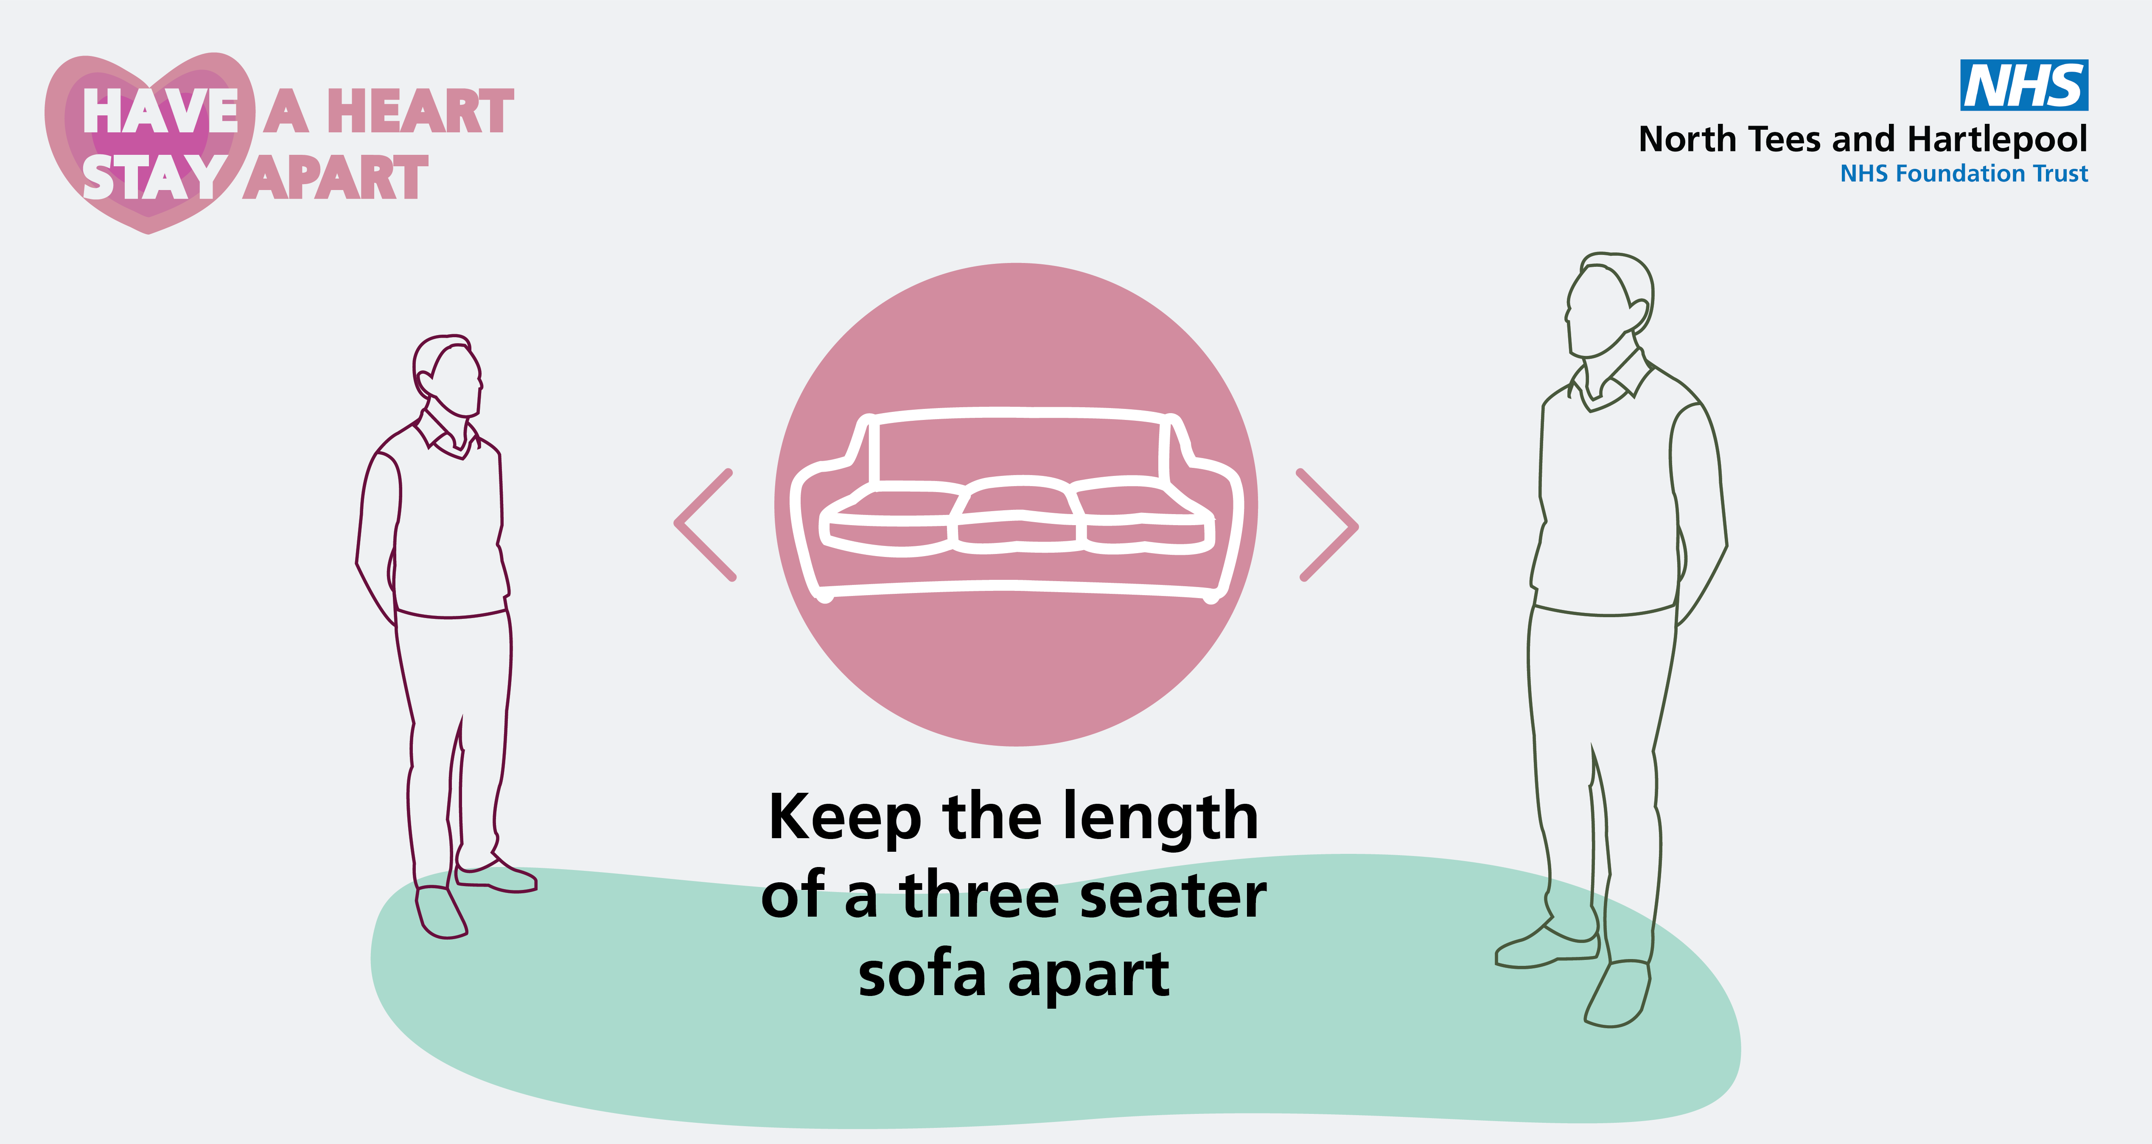
How to Social Distance
Keep 2m apart from others. That’s roughly the length of a 3 seater sofa. This will help reduce the spread of germs.
Notes:
This is a visual guide for children to understand what 2m looks like. You may use other visuals such as the size of a door.
You may want to discuss why we recommend social distancing. You can say:
Viruses can be spread through droplets from the persons mouth whilst they are talking or coughing. The further away you are from the person, the risk of getting the virus reduces as the droplets will drop to the floor.
Raise a discussion around Social Distancing. Explore children’s thoughts and feelings about this.
Explore other ways to visualise 2ms

Slide 10
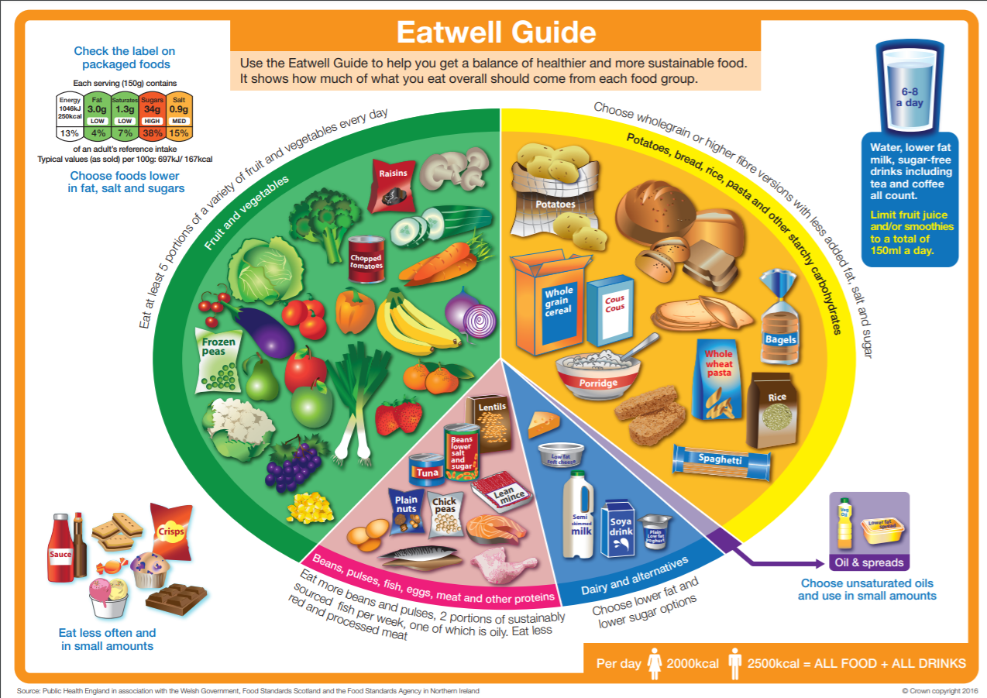
Eating a Healthy Balanced Diet can help strengthen our Immune System
Notes:
Go through each section of the eat well guide and discuss the importance of having a balanced diet with nutritious fruit and veg.
Fruit and veg have immune boosting properties which can fight off infections.

Slide 11
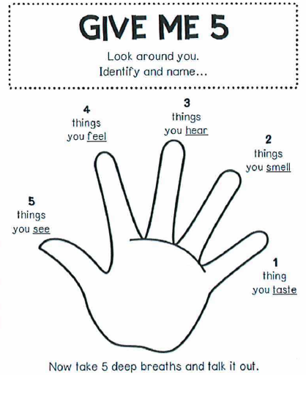
All Feelings Are Normal
We understand that coming back to School may cause a range of different feelings, but all these feelings are normal!
Time.com
If you have any sad or worry feelings, that’s ok ☺ It really helps to talk about these feelings to an adult you trust.
Notes:
Following this pandemic, children may show signs of feeling worried about going back to school or fearful they may catch the virus. Reassure that all these feelings are normal and as long as we wash our hands and stay a safe distance apart that we are doing everything we can to stay healthy.
The Give me 5 hand is a mindfulness grounding technique which helps overwhelming feelings. Use this time to demonstrate with the group if they are engaged.
Ask the children to identify the different emotions that the emojis are expressing.
The star is a breathing technique in which they will follow round the star, breathing in and out slowly. This can also help with anxious feelings.

Slide 12
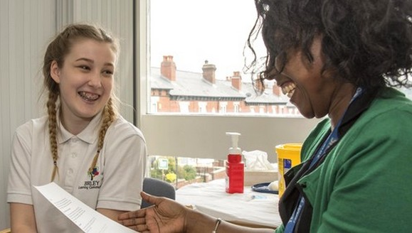
School Nurses are here to help
The School Nursing Team ensure that children and young people living in Southend are happy and healthy.
If you have any health worries, we can help you.
If you’re in Primary School, your grown up at home can call us on
01702 534843 or Text on 07507 331884.
When you go to Secondary School, you will be able to pop by to one of our Drop In Clinics which will be held in a private room in the School.
https://www.sheffieldchildrens.nhs.uk/services/school-nursing/

Slide 13
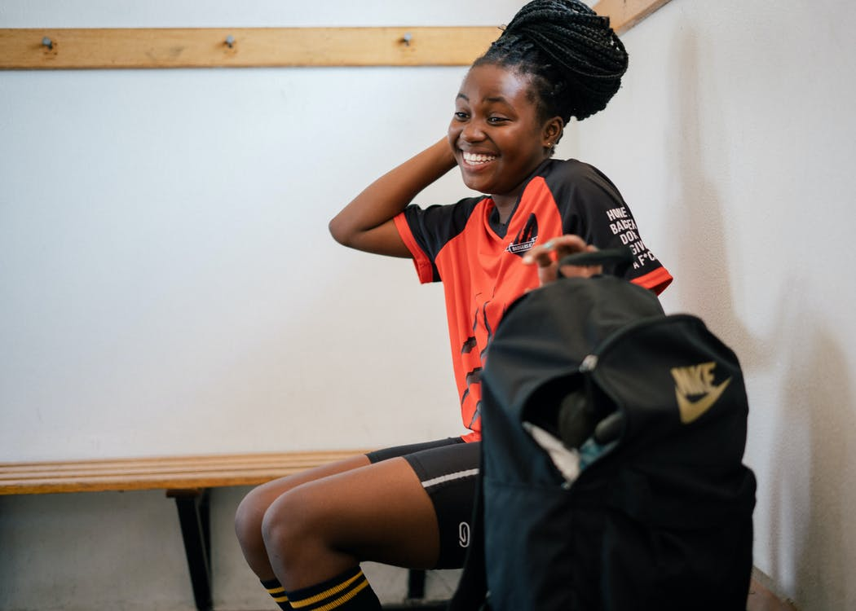
Keep yourself safe and have fun!
Don’t forget to enjoy your time now that you’re back at school. You have all worked really hard at home during lockdown so remember to think about how great it is now that you’re able to get back into school and see some of your friends again ☺
Notes:
This can be a time to discuss any questions after watching the slides.

Slide 14
References
NHS Choices:
https://www.nhs.uk/conditions/coronavirus-covid-19/
https://www.nhs.uk/conditions/coronavirus-covid-19/check-if-you-have-coronavirus-symptoms/
https://www.nhs.uk/live-well/healthy-body/best-way-to-wash-your-hands/
https://www.nhs.uk/live-well/eat-well/the-eatwell-guide/
https://www.nhs.uk/conditions/stress-anxiety-depression/talking-to-children-about-feelings/
Coronavirus (COVID-19): Guidance for Educational Settings: https://www.gov.uk/government/publications/guidance-to-educational-settings-about-covid-19?utm_source=2727113e-7cb7-4453-880c-f6587097e4d6&utm_medium=email&utm_campaign=govuk-notifications&utm_content=immediate
World Health Organisation:
https://www.who.int/gpsc/5may/How_To_HandRub_Poster.pdf
Advice regarding Social Distancing: https://www.gov.uk/government/publications/staying-alert-and-safe-social-distancing/staying-alert-and-safe-social-distancing
Children’s Guide to the Coronavirus: https://www.childrenscommissioner.gov.uk/publication/childrens-guide-to-coronavirus/

