Slide 1
Making the grade: mental health in schools
Andy Bell @CentreforMH @Andy__Bell__
12 January 2021

Slide 2
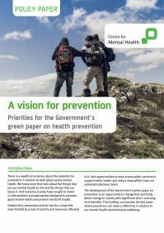
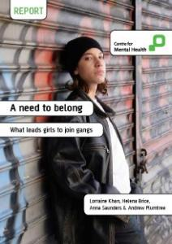
Our role and mission
Research that makes a difference
Translating evidence into policy & practice
Supporting & evaluating innovation
Campaigning for change

Slide 3
Our vision: For all infants, children and young people to grow up in a society that prioritises, invests, listens and attends to their mental health and wellbeing
Notes:
We work with over 190 organisations to campaign and influence policy, with and on behalf of children and young people in relation to their mental health and wellbeing.

Slide 4
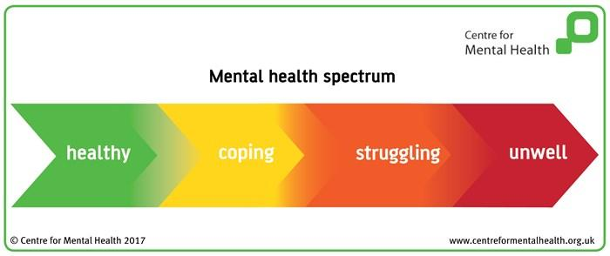
Mental health spectrum
‘We all have mental health’

Slide 5
Rates of child mental ill health
Poor mental health among children and young people rose between 2004 & 2016: from 1 in 10 to 1 in 8 (now 1 in 6)
Biggest rise among girls and young women
Emotional problems now more prevalent than behavioural
Unequal risks: 4 times higher for poorest children by age 11

Slide 6
For every 1,000 young people…

Slide 7
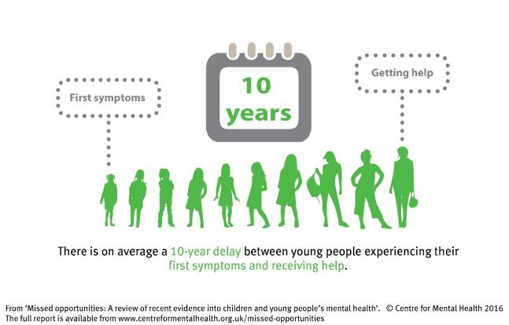
Missed opportunities
Childhood mental health problems are extremely common, can be very persistent and for many cast a long shadow into adult life. Most parents seek help for their children, but few get it.
Notes:
1) These years of delay mean that their problems multiply, sometimes resulting in a distressing crisis and long-term illness. Every day opportunities are being missed to help these children.
2) One child in five has a mental health problem at least once before leaving primary school.
3) And high quality help needs to be offered to young people at the first signs of difficulty

Slide 8
Protective factors for good mental health
Strong parental attachment
Positive parenting
Having a decent income
Security (eg living in secure housing and being in a safe neighbourhood)
Social connection
Fairness

Slide 9
Risk factors for poor mental health
Violence, neglect and abuse
Bullying
Poverty and inequality
Discrimination and injustice
Homelessness and housing insecurity
Crime (and fear of crime)
Traumatic events

Slide 10
Inequalities in risk
Groups of children and young people at higher risk include:
Children whose parents have poor mental health
Children with disabilities and physical illness
Young people from some racialised communities
LGBT+ young people
Children from low income or homeless households
Looked After Children
Children with neurodevelopmental conditions

Slide 11
Making the grade: how education shapes young people’s mental health
Young people from across the UK identified the unique role of schools, colleges and universities in shaping their wellbeing and being a source of support.
But school can also have a detrimental impact on wellbeing and mental health.
https://www.centreformentalhealth.org.uk/publications/making-grade
Notes:
The Health Foundation’s inquiry into young people’s future health identified emotional support as one of four key assets that play a crucial role in young people’s transition to adulthood.
Centre for Mental Health and the Children and Young People’s Mental Health Coalition were commissioned by the Health Foundation to explore schools’ approach to mental health and wellbeing in supporting young people to build the assets for a healthy life.
Four assets: Appropriate skills and qualifications, Personal connections (social networks/mentors), Financial and practical support and emotional support.

Slide 12
How schools can enhance mental health
Relationships: feeling safe, connected & belonging & reliable adults
Environment: spaces to play & secure places to get support
Teaching: culture, arts and life skills as well as mental health education

Slide 13
What gets in the way
Academic pressures: ‘teach to test’ culture
Stereotypes: including for racialised young people
Adversity: including young carers and Looked After Children
Transitions: including from primary to secondary
Inequalities: including ‘hidden curriculum’ of school trips, prizes, assemblies, etc

Slide 14
What helps schools promote wellbeing?
A whole organisation approach to mental health
Leadership and management that values wellbeing
Students having an active role in their learning and a voice in the community
Attention to staff development, health and wellbeing
Effective identification of need for mental health support
Working with parents and carers, with high levels of engagement
Targeted support for particular needs

Slide 15
Barriers to supporting wellbeing in schools
Funding constraints
A lack of staff training and support in mental health
Low levels of wellbeing among school staff
Limited involvement of schools in local health and care partnerships
Inconsistent or limited national guidance
Notes:
is one of a series of reports produced for The Health Foundation’s Future Health Inquiry and is produced with the Children and Young People’s Mental Health Coalition.
The barriers:
Transitions in education
Exam pressures and culture of ‘teaching to test’
Erosion of creative learning and opportunities for exercise

Slide 16
What young people told us:
“My friendship group is what I rely on rather than support services, I’d always rather talk to a friend who knows your background and cares about you” – Young person from Bristol, England
“I think it’s harder for boys to talk to someone, see us girls we just natter to anyone but [I] don’t know if there’s any male role models out there” – Young person from North Ayrshire, Scotland
“At school you’re told exams are everything, but they’re not everything. We still have feelings, but feelings don’t seem to matter any more. The stress is too much” – Young person from North Ayrshire, Scotland
Notes:
Listen to and act on what children and young people say
Easier access to mental health support – when, where and how they want to access it
But also want choice – schools or in community
Learning how to look after their own mental health
Want teachers to have some knowledge of mental health and wellbeing
Improve transitions to adult services
Reduce stigma

Slide 17
What young people told us:
“Our school doesn’t have money to take us out and learn practically” -Young person from Bradford, England
“If you go and seek help then you are being labelled and people treat you differently, the system in school lets everyone know that you are seeking help” – Young person from Denbighshire, Wales
“You are supported if you want a big career like a doctor etc but not if you want to do arts” – Young person from Lisburn, Northern Ireland
Notes:
Listen to and act on what children and young people say
Easier access to mental health support – when, where and how they want to access it
But also want choice – schools or in community
Learning how to look after their own mental health
Want teachers to have some knowledge of mental health and wellbeing
Improve transitions to adult services
Reduce stigma

Slide 18
Trauma and restrictive interventions
About 1/3 young people experience a traumatic event
Of these about ¼ will experience symptoms of post-traumatic stress disorder (PTSD)
Higher risk of trauma exposure among children with behavioural problems, ADHD, autistic spectrum disorders and learning disabilities + most marginalised & disadvantaged social groups

Slide 19
Trauma and challenging behaviour are linked:
Trauma causes challenging behaviour:
Changes stress responses, leading to impulsivity & poor emotional control
Challenging behaviour causes trauma:
Greater exposure to high risk situations, eg greater danger of brain injury
Both may be independently caused by common factors

Slide 20
Trauma and restrictive interventions
Restrictive interventions have negative impacts on mental health regardless of previous experiences
Similarities between current situation and past distress may trigger stress response in those affected by trauma, eg:
Children who have been neglected or separated from caregiver may find seclusion or exclusion more distressing

Slide 21
Trauma, challenging behaviour & RI

Slide 22
Alternative strategies
Positive behavioural support:
Reduces use of restrictive interventions by helping child manage behaviour
But doesn’t change external environment
Trauma-informed schools:
Social and emotional learning
Safe and caring environment
Positive experience of reliable adults
Support for staff wellbeing

Slide 23
‘This is me’
Guide for schools produced by young men from Shifting the Dial project in Birmingham
“We need more teachers who get to the point – not ‘Where’s your tie?’, but ‘Do you need a tie?’ - immediately offering help and not embarrassment… if his shirt isn’t tucked in, he just needs to be taught that’s not how he can move on in professional society… through this whitecentric world in which he is so undermined and forgotten about and pushed under.”
www.centreformentalhealth.org.uk/this-is-me

Slide 24
Covid-19 and children’s mental health
Significant and lasting effects including:
Trauma, bereavement and loss
Isolation and loneliness
Worries about the future
Estimated 1.5m children will need additional mental health support as a direct result
Current investment in wellbeing in schools way below academic catch-up funding
Can we ‘build back better’ in schools?

Slide 25
Thank you
For more information:
andy.bell@centreformentalhealth.org.uk
@CentreforMH @MH_Challenge @Andy__Bell__
www.centreformentalhealth.org.uk

