Slide 1




Safeguarding children and Young People:
What has COVID shown us?
Kenny Gibson
National Head of Safeguarding for NHS
@KennyGibsonNHS
@NHSSafeguarding

Slide 2
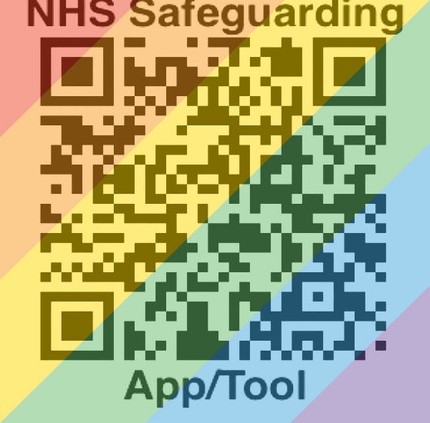



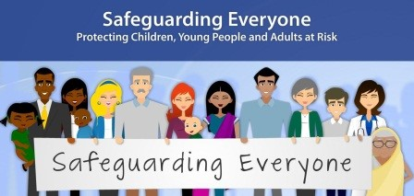

Find out more
Visit:
http://www.myguideapps.com/projects/safeguarding/default/
Follow #NHSSafeguarding @NHSSafeguarding
Notes:
This is only a glimpse of the achievements attained over the last year and a hint at our priorities going forward. For more information I would encourage you to view the recently published 2018 Safeguarding Annual Update, which contains a comprehensive update on all the work areas within the NHS England national safeguarding portfolio.
This can be easily downloaded from the NHS England Safeguarding website at the link onscreen or simply Google: 2018 safeguarding annual update
To follow the work we do, you can join us online with the twitter hashtag NHS Safeguarding.
Details regarding the NHS England 6th National Safeguarding Conference will be released in due course. This free to attend event promises to be our biggest yet.
Finally I would like to thank you for your time and I hope you enjoy the rest of the day.

Slide 3

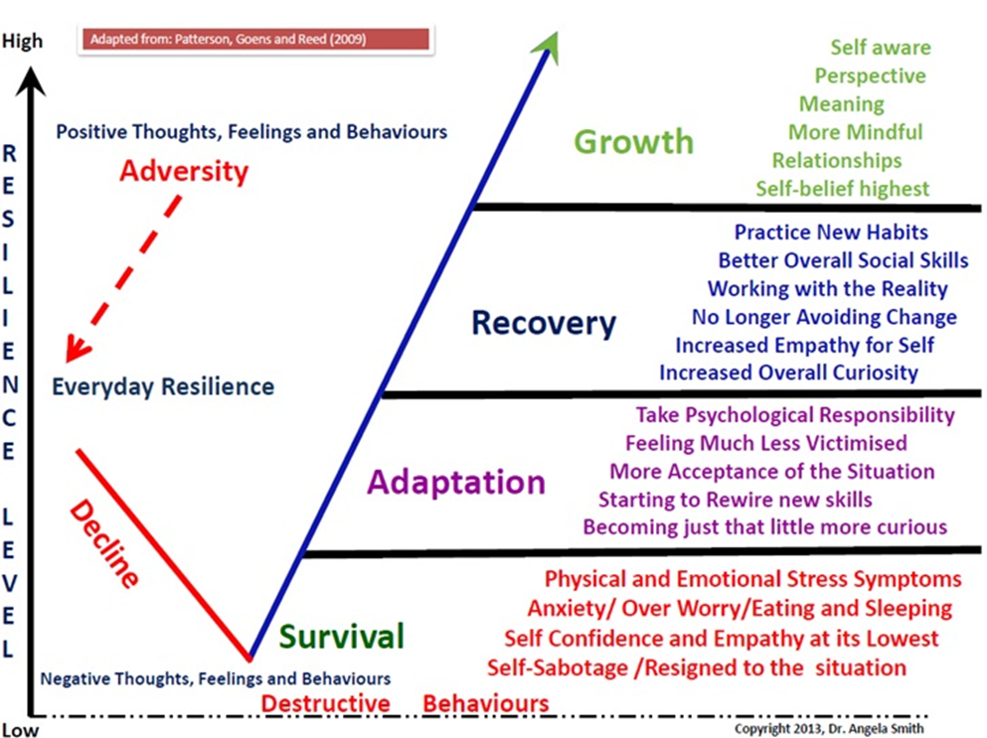
Safeguarding requires resilience
Notes:
Clinicians, carers and citizens need resilience so we have created ......
Policies and protocols
NHS Safeguarding App
Chaperoning Guidance
Trusted list
Grab-sheets
We have partnered with ~
MAAP
Essential Parent
These will support you ~
Adaptive conversations
Be curious, ask the question,
Here are the 10 tips for adaptive conversation:
1. Know your purpose
First and foremost, it's important to figure out why you are having the conversation.
Your intentions should be more than simply to "get something off your chest," which implies a one-sided dialogue. Instead, they should include the other person, too, and your shared reasons for having the conversation.
2. Know your goal
Knowing your goal goes hand in hand with knowing your purpose, but focuses on the outcomes of the conversation. Outline what you hope to achieve from the discussion and your reasons for it.
3. Preparation is key
Once you've worked out your purpose and your goal, think about a few key messages that will help you convey them. Also give some thought to your conversation partners' likely reactions and how you will deal with them.
That does not mean writing a script, however. You should be able to respond as the conversation develops — the other person's response might just surprise you.
4. Stay on message
Once you're ready to have the conversation, make sure you stay true to those key messages and don't let yourself be derailed by the other person's emotions or reactions.
5. Listen actively
Keep an eye out for what is being communicated both verbally and non-verbally. For example, does their body language match what they are saying?
Always remember listen and silent have the same letters for a reason.
When responding, make sure you take the whole picture into account.
6. Ask questions
Gain a better understanding of their point of view by asking questions. Open questions are best for drawing out insightful responses, while "why" questions can provoke defensiveness and should be avoided.
7. Show empathy
Try to put yourself in the other person's shoes and be empathetic to their feelings. Avoid talking about yourself and your experiences and focus on the impact of the situation for them specifically.
8. Be open-minded
Try to approach the conversation with an open mind. If you're harbouring negative feelings then it's far less likely to result in a positive outcome. Plus, there's always a chance that you could be wrong.
9. Recognise their right
Understand that they have a right to be angry, upset, frustrated or emotional about your comments, especially if you have given critical feedback or unwelcome news.
Sometimes the most valuable outcome from a difficult conversation can be giving the other person the opportunity to express themselves and feel heard.
10. Know that the end of the conversation is not the end
Finally, make sure you're available to deal with the possible fallout from the conversation. If you can't be, you should perhaps think twice about having it.

Slide 4
NHS Safeguarding Programmes
Designated Professionals & Named Practitioners
National & Regional Safeguarding Teams
National Safeguarding Steering Group
Clinical Reference Groups
National Safeguarding Networks
Local
Safeguarding
Partnerships
Integrated
Care
Systems
Domestic Abuse & Violence
Tackling Serious Violence
Child Sexual Abuse & Exploitation (IISCA)
Looked After Children + CPIS
Contextual Safeguarding Dashboard
Mental Capacity Act
National Network for DHPs
Safeguarding Adults National Network
Maternity Safeguarding Network
Named Safeguarding GP Network
Notes:
Safeguarding means protecting people’s health, wellbeing and human rights, and enabling them to live free from harm, abuse and neglect.
NHS England is dedicated to ensuring that the principals and duties of safeguarding adults and children are holistically, consistently and conscientiously applied and its part of my role to ensure that we work together with a number of partner agencies to successfully protect the most vulnerable people in our society.
The National Safeguarding Team provide leadership and guidance to all NHS health staff.
For those unaware, the mandate of the national team covers a large number of work areas and encompasses a number of:
[click] working groups,
[click] networks,
[click] and task and finish groups.
Are you a member of National Network?
Do you know who your Regional Safeguarding Lead is?
Do you know how to escalate a concern to your local Designated Safeguarding Professional?

Slide 5
NHS Safeguarding Mandate
The Paramountcy of the Child
  Child Protection Information System
  Working Together Local Safeguarding Plans
Principles of Adult Safeguarding
  Empowerment
  Prevention
  Proportionate
  Protection
  Partnership
  Accountable

Slide 6
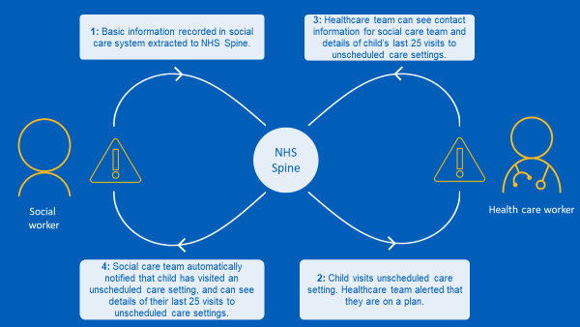
Child Protection Information System as at 09/12/2020
Total Plans Uploaded: 208,718 ⬆
                98.7% unscheduled healthcare settings live + SCRa
                8,000+ alerts each month
                During COVID we have implemented Section 259 to flow data from CPIS to 0-19 – what about GP; Paeds; LAC, SEND & CAMHS colleagues?
                Phase 2 scoping – for GP & community services; Was Not Brought flags; Named Nurses, HV, SN and GP access
Notes:
CP-IS is an innovative digital project produced in partnership between NHS England and NHS Digital.
CP-IS, the first of its kind in the world, links IT systems used by the local authorities and health services across England, with the aim of helping organisations share information securely and quickly to better protect vulnerable children and young people.
So what is CP-IS and how does it work?
When a child comes to the attention of children’s services and is put on a Child Protection Plan or becomes a Looked After Child, the social worker enters details into their existing social care IT systems. But for CP-IS to work, they now also routinely enter the child’s NHS Number.
[click] Basic information about that plan is automatically extracted and sent securely to the NHS Spine every day. The Spine is the backbone of NHS services, linking more than 20,000 healthcare organisations in England.
If that child presents for care at an unscheduled care setting that has implemented CP-IS, the health team is alerted that they are on a plan.
They are also given the contact details for the social care team responsible. This enables the health team to make immediate contact with that child’s social worker if they have safeguarding concerns. They can also see details of the child’s last 25 presentations for care at unscheduled care settings across England.
The social care team receives a notification automatically so they are also aware that the child has presented. And they can also see details of the child’s previous 25 visits to unscheduled care settings anywhere in England. This can help the social care team to identify patterns of neglect and abuse.
We are all aware of high profile cases of neglect and abuse such as those involving Peter Connelly, Victoria Climbie and Hamzah Khan. But poor communication and information sharing between agencies is identified as a factor in the majority of serious case reviews that take place following the death or injury of a child.
In 2008, Government asked Lord Laming to conduct a review of child protection. This identified the need for better information sharing, particularly between children’s social workers and health settings, such as emergency departments, minor injury units – anywhere a child could present for unplanned care.
The Child Protection - Information Sharing project was therefore commissioned by the Department of Health, NHS England and the Department for Education and is being delivered by the project team at NHS Digital with support from NHS England.
It is important to note that CP-IS builds on existing safeguarding arrangements between health and social care. It does not replace existing arrangements. But CP-IS is the first national system of its kind which helps us to protect children who are taken away from their home area, where local safeguarding arrangements will not protect them. And it is helping organisations locally to work much more closely together in the best interests of vulnerable children.

Slide 7
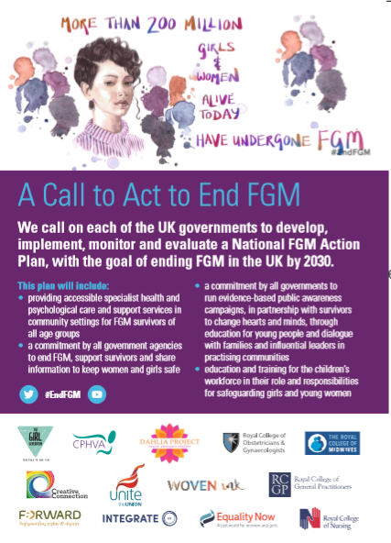
Female Genital Mutilation
                Empower and support victims and survivors
                Raise culturally sensitive awareness
                FGM is safeguarding
                FGM is child abuse
                Document & collect data
                Share information
                Empower frontline professionals
                Campaigns #EndFGM
Provide clear guidance to health sector (Royal Colleges, CCGs, ICSs, providers in NHS and private sector) regarding what good service commissioning and delivery looks like
Build the evidence base for what works in prevention and treatment
Continue to support data-driven local prevention infrastructure
Address FGM as part of wider violence against women & girls and safeguarding strategies
Notes:
We need to remind all staff they have a duty to report FGM

Slide 8
PREVENT within our NHS
PREVENT – stop people becoming terrorists and supporting violent extremism
Pursue – stop terrorist attacks and citizens of noted interest
Protect – strengthen overall protection against terrorist attacks
Prepare – where we cannot stop an attack, mitigate its impact
The specific PREVENT objectives that relate to healthcare services are to:
Support individuals who are vulnerable to being groomed into becoming terrorists, or are already being groomed by violent extremists
Disrupt those who promote violent terrorism and support the places where they operate
Address the grievances which radicalisers are exploiting
Notes:
The specific PREVENT objectives that relate to healthcare services are to:
Support individuals who are vulnerable to being groomed into becoming terrorists, or are already being groomed by violent extremists
Disrupt those who promote violent terrorism and support the places where they operate
Address the grievances which radicalisers are exploiting
But how does this happen in reality?
The NHS is complex; a trusted-brand with many interconnected parts ~
Our GP or practice nurse we visit for our vaccinations and such like;
our community pharmacy we visit ever 28 days to pick up our medication;
our NHS dentist we visit annually;
our outpatient department receptionist, nurse or doctor;
our mental health team;
our learning disability key worker;
our porter whilst they are taking us for an investigation;
our ward nurse or care assistant who is looking after us in the hospital or nursing home;
our district nurse who comes twice a week to dress our leg ulcer;
our health visitor;
our school nurse;
Anyone of these contact points can be the trigger that allows someone to voice concerns about someone being radicalised.
Or it can be the moment with these diligent staff hear or see someone which indicates possible radicalisation.

Slide 9
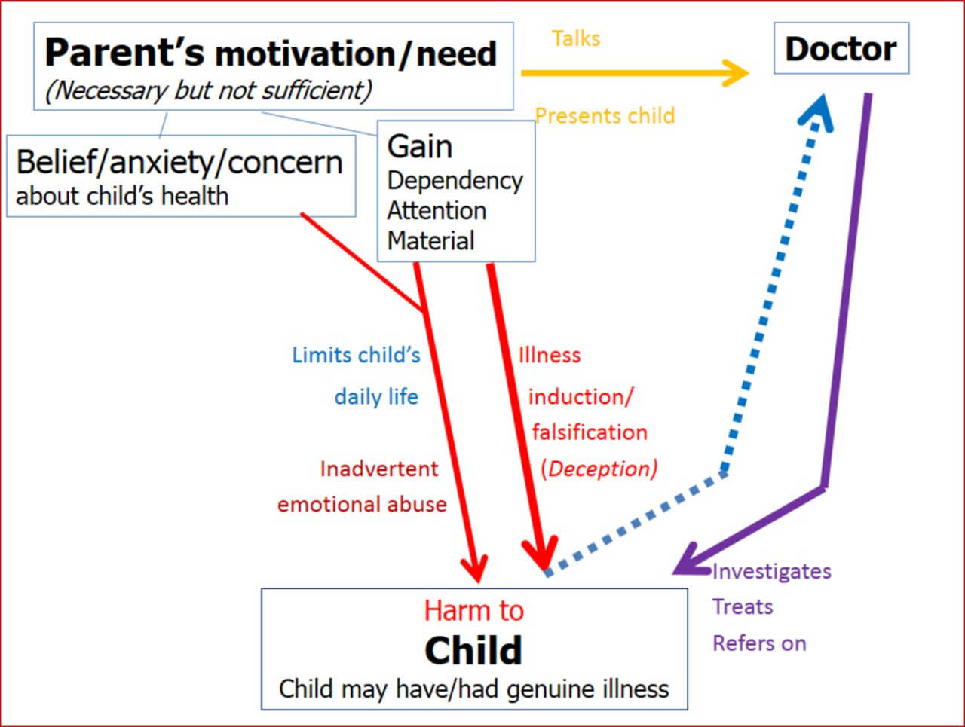
Fabricated Injuries and Illnesses (FII)
This is complex situation that can include coercive control of staff.
This can lead to safeguarding alerts at local, regional, national or international level.
Social media is a huge challenge
Notes:
Fabricated or induced illness (FII) is a rare form of child abuse. It occurs when a parent or carer, usually the child's biological mother, exaggerates or deliberately causes symptoms of illness in the child.
FII is also known as "Munchausen's syndrome by proxy" (not to be confused with Munchausen's syndrome, where a person pretends to be ill or causes illness or injury to themselves).
Signs of fabricated or induced illness
Fabricated or induced illness (FII) covers a wide range of symptoms and behaviours involving parents seeking healthcare for a child. This ranges from extreme neglect (failing to seek medical care) to induced illness.
Behaviours in FII include a mother or other carer who:
persuades healthcare professionals that their child is ill when they're perfectly healthy
exaggerates or lies about their child's symptoms
manipulates test results to suggest the presence of illness – for example, by putting glucose in urine samples to suggest the child has diabetes
deliberately induces symptoms of illness – for example, by poisoning her child with unnecessary medicine or other substances
Learn more about the signs of fabricated or induced illness.
How common is FII?
It's difficult to estimate how widespread FII is because many cases may go unreported or undetected but it is thought to be very rare.
One study published in 2000 estimated 89 cases of FII in a population of 100,000 over a 2-year period. However, it's likely that this figure underestimates the actual number of cases of FII.
FII can involve children of all ages, but the most severe cases are usually associated with children under 5.
In around 85% of reported cases of FII, the child's mother is responsible for the abuse. However, there have been cases where the father, foster parent, grandparent, guardian, or a healthcare or childcare professional was responsible.
Why does fabricated or induced illness occur?
The reasons why FII occurs are not fully understood. In cases where the mother is responsible, it could be that she enjoys the attention of playing the role of a "caring mother".
A large number of mothers involved in FII have borderline personality disorders characterised by emotional instability, impulsiveness and disturbed thinking.
Some mothers involved in FII have so-called "somatoform disorders", where they experience multiple, recurrent physical symptoms. A proportion of these mothers also have Munchausen's syndrome.
Some carers have unresolved psychological and behavioural problems, such as a history of self-harming, or drug or alcohol misuse. Some have experienced the death of another child.
There have also been several reported cases where illness was fabricated or induced for financial reasons – for example, to claim disability benefits.
Read more about the possible causes of fabricated or induced illness.
What to do if you suspect a child is at risk
FII is a child safeguarding issue and cannot be managed by the NHS alone.
Medical professionals who suspect FII is taking place should liaise with social services and the police and must follow local child safeguarding procedures.
If your job involves working with children – for example, if you're a nursery worker or teacher, you should inform the person in your organisation who's responsible for child safeguarding issues. If you do not know who this is, your immediate supervisor or manager should be able to tell you.
If you suspect that someone you know may be fabricating or inducing illness in their child, you should not confront them directly. It's unlikely to make the person admit to wrongdoing, and it may give them the opportunity to dispose of any evidence of abuse.
You can contact your local social services department or telephone the NSPCC's child protection helpline on 0808 800 5000. It's open 24 hours a day, 7 days a week.
How a case is managed
The child
The first priority is to protect the child and restore them to good health. This may involve removing the child from the care of the person responsible. If the child is in hospital, the parent or carer may need to be removed from the ward.
The child may need help returning to a normal lifestyle, including going back to school. Younger children and babies who do not understand they were victims of abuse often make a good recovery once the abuse stops.
Older children, particularly those who've been abused for many years, will have more complex problems. For example, many affected children believe they're really ill. They need help and support to develop a more realistic understanding of their health. They may also need to learn how to tell the difference between the impaired perception of their parent or carer and reality.
It's common for older children to feel loyal to their parent or carer, and a sense of guilt if that person is removed from the family.
The parent or carer
Once the child is safe, it may be possible to treat the parent or carer's underlying psychological problems. This may include a combination of:
intensive psychotherapy
family therapy
The aim of psychotherapy is to uncover and resolve the issues that caused the person to fabricate or induce illness in their child.
Family therapy aims to resolve any tensions within the family, improve parenting skills and attempt to repair the relationship between the parent or carer and the child.
In more severe cases, the parent or carer may be compulsorily detained in a psychiatric ward under the Mental Health Act so their relationship with their child can be closely monitored.
Parents or carers involved in FII are difficult to treat because most do not admit their deceptions and refuse to recognise their abusive behaviour. So in some cases, the child is permanently removed from their care.
The best results occur in cases where the parent or carer:
understands and acknowledges the harm they've caused
is able to communicate the underlying motivations and needs that led them to fabricate or cause illness
is able to work together with healthcare and other professionals
Media controversy
There has been controversy in the media regarding FII, with some commentators suggesting that it's not a real phenomenon.
However, a great deal of evidence exists to show that FII is real. The evidence of abuse includes hundreds of case files from more than 20 different countries, the confessions of mothers and other carers, the testimony of children, as well as video footage.

Slide 10
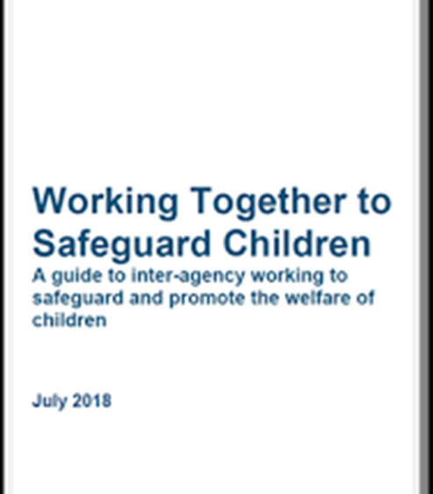

Working Together Reforms
Wood Report 2016
Children & Social Work Act 2017
Working Together 2018
Three strands:
Safeguarding Partnerships
Child Death Reviews
Safeguarding Practice Reviews
Three
equal
partners,
one shared mission with unified
partnership plan
Health
(CCG)
Police
Local Authority
Notes:
We must support health leaders to be equal partners.

Slide 11
Safeguarding Practice Reviews
National Panel
Rapid Reviews
Local Child Safeguarding Practice Reviews
National Child Safeguarding Practice
Reviews
Rapid review process 15 day deadline proving a challenge
First national review into children harmed by criminal exploitation
Notes:
We must undertake safeguarding practice reviews

Slide 12
Child Death Reviews
Health
Local Authority
CDR
Partnership
Arrangements currently under review by NHSE/I and DHSC
Required to submit data to National Child Mortality Database
Notes:
The NHS leads on Child Death Reviews

Slide 13

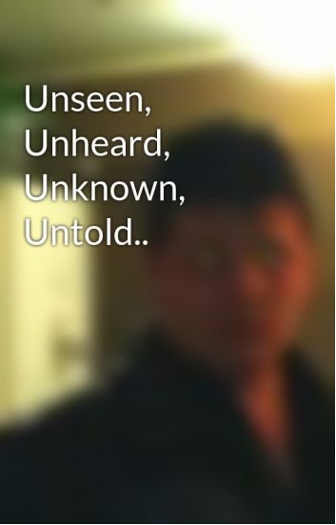
Safeguarding in 2020
Challenge social norms
Challenge unconscious bias
Creating a common language
Notes:
Profiling social norms – children cannot unsee or unhear violence and abuse
Challenging unconscious bias – professional curiosity to check and challenge behaviours
Create a common language-collaborate with unified data set and use lived experience narrative, including nuanced context

Slide 14
Safeguarding in 2020 has many lenses
The voice of victims & survivors; the mindset & motivations of perpetrators & offenders
Adverse childhood experiences ……….and beyond
Think family
Independent inquiry on child sexual abuse (The Truth Project)
Female genital mutilation
Child sexual exploitation and abuse
Sexual assault and abuse service strategy
Self harm and fabricated injuries & illnesses
Safeguarding within health in the justice system & armed forces
Trauma informed practice
Serious violence, county lines, gangs & grooming
Exploitation - sexual; financial, scams, coercion,
Making safeguarding personal
Missing persons
Modern slavery & human trafficking
Prevent
Sports abuse
DarkWeb
You can do anything, but not everything
https://contextualsafeguarding.org.
Notes:
We are now collaborating with XGov and Partners to move towards contextual safeguarding.

Slide 15
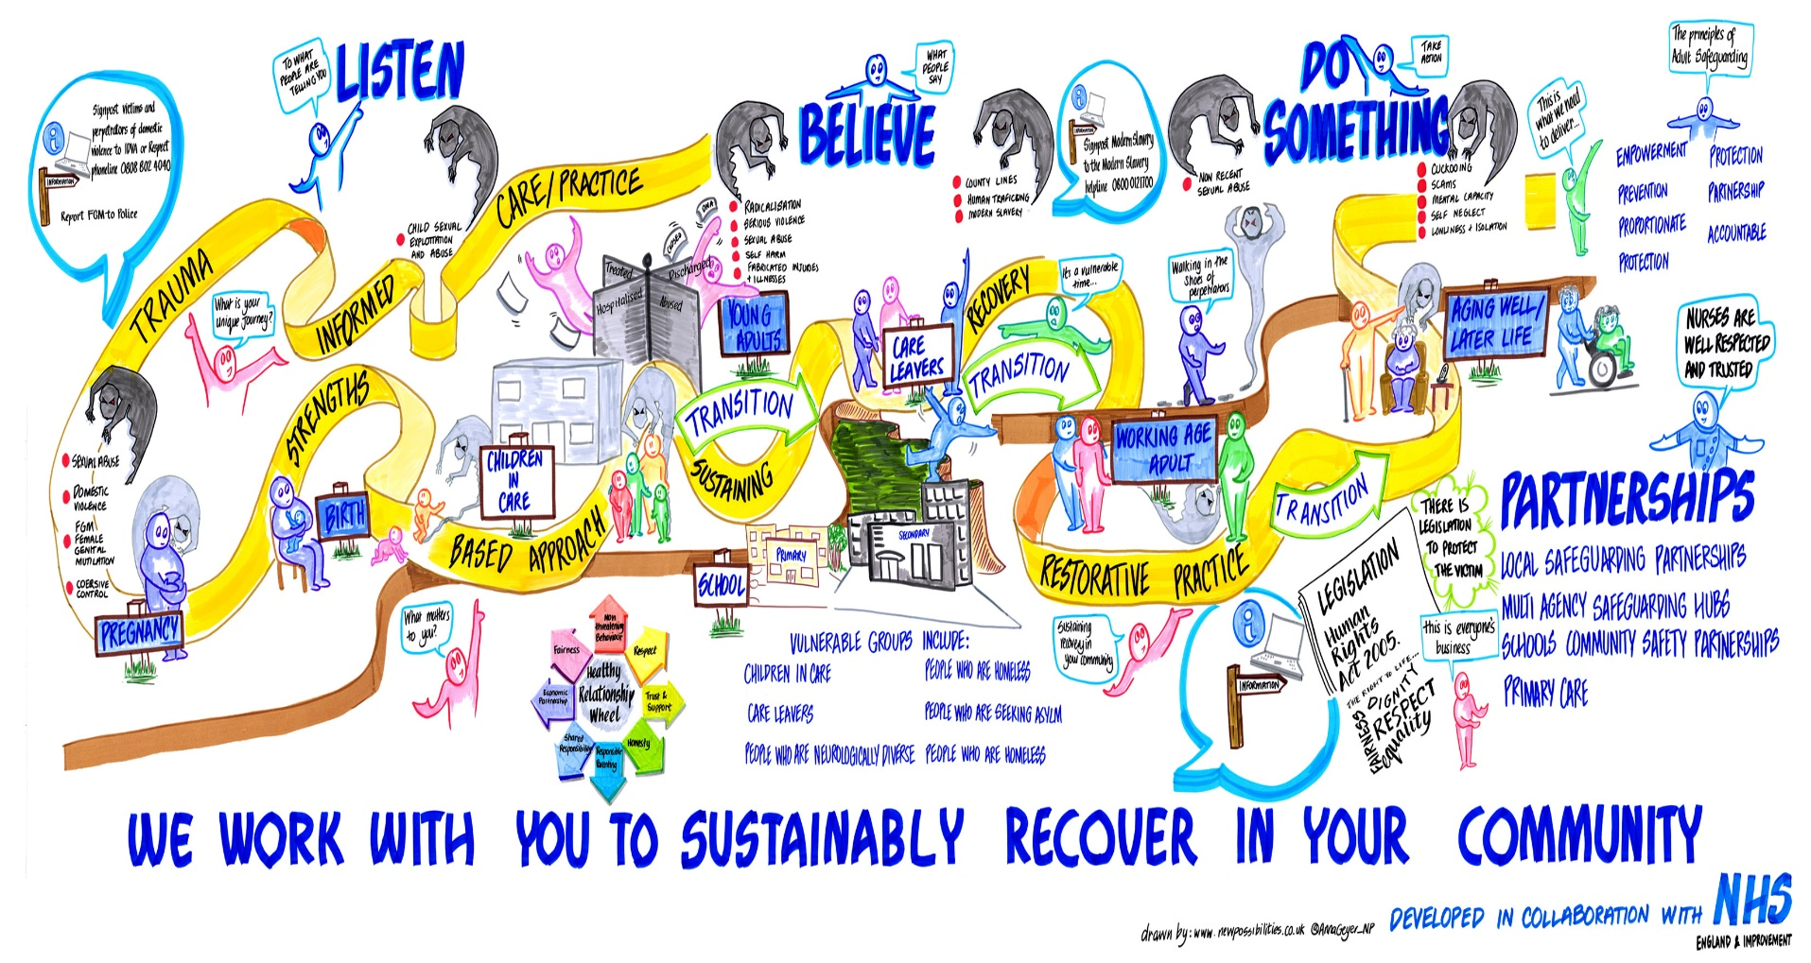

Slide 16

Our aspirations for the future
Place and space safeguarding data
Trauma Informed Practice
Contextual safeguarding
Strengths based approach
Inclusive NHS for victims, survivors, perpetrators & offenders
Lived Experience Narrative
Notes:
Blueprint of integrated care tackling serious violence over 6 months , work with designate professionals roll out over 2 years every ICS

Slide 17
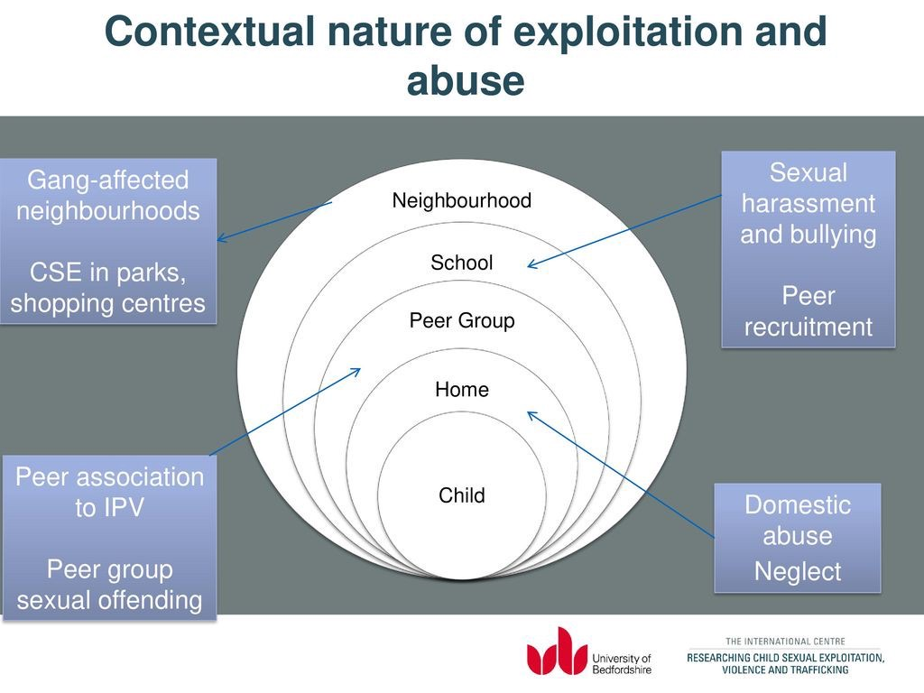
Contextual Safeguarding has several layers
Have you considered making a place or space referral?
Have you collaborated with Community Safety Partnerships or Violence Reduction Units?
Notes:
Contextual Safeguarding has been developed by Carlene Firmin at the University of Bedfordshire over the past six years to inform policy and practice approaches to safeguarding adolescents. Contextual Safeguarding is an approach to understanding, and responding to, young people’s experiences of significant harm beyond their families. It recognises that the different relationships that young people form in their neighbourhoods, schools and online can feature violence and abuse. Parents and carers have little influence over these contexts, and young people’s experiences of extra-familial abuse can undermine parent-child relationships.
Therefore children’s social care practitioners need to engage with individuals and sectors who do have influence over/within extra-familial contexts, and recognise that assessment of, and intervention with, these spaces are a critical part of safeguarding practices. Contextual Safeguarding, therefore, expands the objectives of child protection systems in recognition that young people are vulnerable to abuse in a range of social contexts.

Slide 18
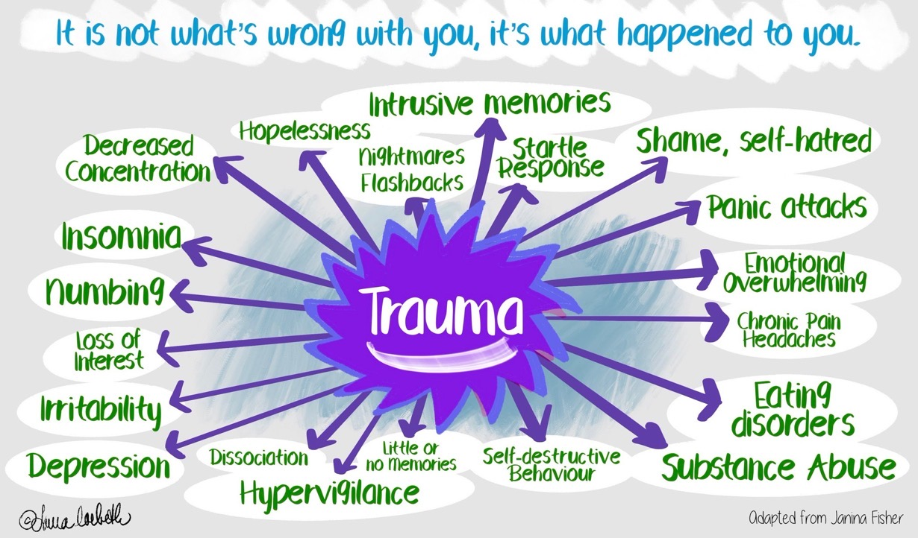
Trauma Informed Practice
A person with problems, not a patient with an illness
What happened to you?
Notes:
What Is Trauma Informed Care?
Individual trauma results from an:
Event, series of events, or set of circumstances that is
Experienced by an individual as physically and/or emotionally harmful or threatening and that has lasting adverse
Effects on the individual’s functioning and/or physical, social, emotional, or spiritual well-being.
How Prevalent Is Trauma?
61% of men and 51% of women report exposure to at least one lifetime traumatic event
In public behavioral health settings, 90% of clients have experienced trauma
As Hodas (2005) eloquently states: “We need to presume the clients we serve have a history of traumatic stress and exercise “universal precautions” by creating systems of care that are trauma-informed.“
—> We all need to provide trauma-informed care to ensure the best possible health outcomes.
A trauma-informed approach incorporates:
Realizing the prevalence of trauma
Recognizing how it affects all individuals involved with the program, organization or system, including its own workforce
Resisting re-traumatization
Responding by putting this knowledge into practice
Core Principles of a Trauma-Informed System of Care:
Safety – ensuring physical and emotional safety
Trustworthiness – maintaining appropriate boundaries and making tasks clear
Choice – prioritizing (staff) consumer choice and control (people want choices and options; for people who have had control taken away, having small choices makes a big difference)
Collaboration – maximizing collaboration
Empowerment – prioritizing (staff) consumer empowerment and skill-building
7 Domains of Trauma-Informed Care:
Early screening and comprehensive assessment – If the client isn’t talking, ask: “What’s happened?” (Don’t ask: “What’s wrong with you?”) Not everyone is ready to talk but we give them permission to talk when they are ready.
Consumer driven care and services – Listen to the people who are coming to us for services. Ask them if you can improve your services. Ask what can we do to help you better?
Trauma-informed, responsive and educated workforce – Everyone in the system from the receptionist through the doctor matters. Disrespect can be triggering.
Emerging and evidence-informed best practices – We need to use universal precautions. We need to expect either childhood experience or a current trauma but once we ask what happened, we need to provide EBP assistance.
Safe and secure environments – It is important for the clinician to make it safe for the client. The organization also needs to make the client feel safe and comfortable (or is the waiting room dingy and dark?).
Create trauma-informed community partnerships – This is very important to include in our work. Reach out to other organizations such as schools, the juvenile justice system etc. We need to spread this information to our partners in the community.
Develop a performance monitoring system – Develop a data collection system to demonstrate what are the outcomes that you are seeing.

Slide 19
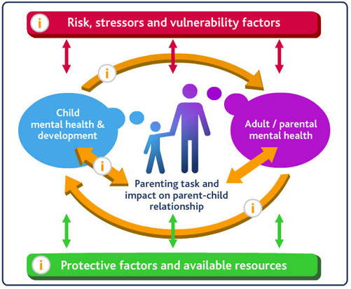
Think Family –
The Crossing Bridges Family Model (Falkov 1998)
For children, all protective strategies operate through one or more of the following processes:
by altering the child's perceptions of, or exposure to, risk of harm
by reducing the cumulative effect of risk factors compounding each other
by helping the child improve her/his self-esteem and self-efficacy
by creating opportunities for change
seasonal safeguarding
Avoid pinches becoming punches
Notes:
The Think Family agenda recognises and promotes the importance of a whole-family approach which is built on the principles of 'Reaching out: think family' -
No wrong door – all service should offer an open door into a system of joined-up support. This is based on more coordination between adult and children's services.
Looking at the whole family – services working with both adults and children take into account family circumstances and responsibilities. For example, an alcohol treatment service combines treatment with parenting classes while supervised childcare is provided for the children.
Providing support tailored to need – working with families to agree a package of support best suited to their particular situation.
Building on family strengths – practitioners work in partnerships with families recognising and promoting resilience and helping them to build their capabilities. For example, family group conferencing is used to empower a family to negotiate their own solution to a problem.
The Family Model
The Crossing Bridges Family Model (Falkov 1998) is a useful conceptual framework that can help staff to consider the parent, the child and the family as a whole when assessing the needs of and planning care packages for families with a parent suffering from a mental health problem. The model illustrates how the mental health and wellbeing of the children and adults in a family where a parent is mentally ill are intimately linked in at least three ways (see Figure 1):
parental mental health problems can adversely affect the development, and in some cases the safety, of children
growing up with a mentally ill parent can have a negative impact on a person's adjustment in adulthood, including their transition to parenthood
children, particularly those with emotional, behavioural or chronic physical difficulties, can precipitate or exacerbate mental ill health in their parents/carers.
The Model also identifies that there are risks, stressors and vulnerability factors increasing the likelihood of a poor outcome, as well as strengths, resources and protective factors that enable families to overcome adversity.

Slide 20
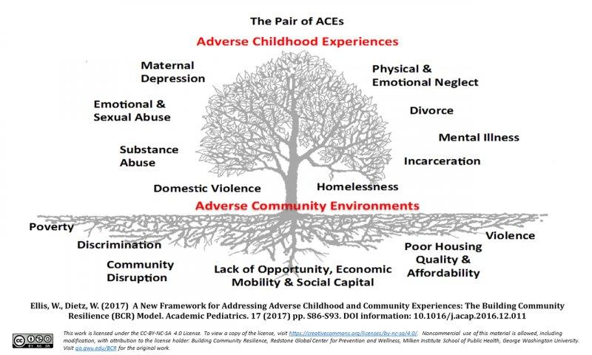
Adverse Childhood Experiences
Defining Adverse Childhood Experiences and their
prevalence among adults in England from: Bellis et al, 2014
Child maltreatment
Verbal abuse 17.3%
Physical abuse 14.3%
Sexual abuse 6.2%
Childhood household included
Parental separation 22.6%
Domestic violence 12.1%
Mental illness 12.1%
Alcohol abuse 9.1%
Drug use 3.9%
Incarceration 4.1%
We should note ‘cumulative harm’
Shit Life Syndrome ~
http://publichealthy.co.uk/good-intentions-but-the-right-approach-the-case-of-aces/
Notes:
Adverse Childhood Experiences (ACEs) are traumatic events that affect children while growing up, such as suffering child maltreatment or living in a household affected by domestic violence, substance misuse or mental illness.
This short animated film has been developed to raise awareness of ACEs, their potential to damage health across the life course and the roles that different agencies can play in preventing ACEs and supporting those affected by them.
Defining Adverse Childhood Experiences and their prevalence among adults in England from: Bellis et al, 2014
Child maltreatment
Verbal abuse 17.3%
Physical abuse 14.3%
Sexual abuse 6.2%
Childhood household included
Parental separation 22.6%
Domestic violence 12.1%
Mental illness 12.1%
Alcohol abuse 9.1%
Drug use 3.9%
Incarceration 4.1%
The ACEs construct suggests that the more ACEs which impacts on a child’s formative years, the greater the chance that that child will have long term cognitive damage affecting their decision-making.
So what happens in the brain to cause long lasting harm?
Loads of research has been ongoing about ACEs and you can find reports on PHE and other evidenced-based webpages.
Routine Enquiry About Childhood Adversity (REACh)
REACh was implemented across a large multi-site general practice in the North West of England from April to October 2017. Using qualitative and quantitative data, this report considers the feasibility and acceptability of ACE enquiry in general practice from both the patient and the practitioner perspective, and provides some initial insight into the potential impact of ACE enquiry on service delivery and patient health outcomes.
This report is intended as a proof of concept study for ACE enquiry in general practice and explores key findings from the evaluation of a pathfinder study for one such approach - Routine Enquiry About Childhood Adversity (REACh)
Here is the full report ~ http://www.aces.me.uk/files/2215/3495/0307/REACh_Evaluation_Report.pdf
The Pair of ACEs Tree demonstrates the interconnectedness social circumstances and adverse experiences of their family environment. The leaves on the tree represent the ‘symptoms’ that are easily recognized in clinical, educational and social service settings, but the underlying causes are the usual suspects: a lack of affordable and safe housing, community violence, inequality, discrimination, poverty, etc..
If difficult lives (or ‘adverse socioeconomic circumstances’) are the root cause of ACEs, then I’m not sure we even need distinct ACEs prevention strategies; it’s the same as preventing everything else. What we need is the funding and freedom to develop broad prevention approaches that focus upstream. A living wage. Clean streets. Good, affordable housing. Parks. Stuff for teenagers to do. Welfare. Jobs. Childcare. Good schools. Of course, we could never prevent everything, so we will always need access to excellent individual support. But that is not going to reduce the incidence. Trauma-informed practice and proper help for individuals is absolutely essential, but it’s not really prevention is it? We need to tackle the roots of the problem too.
ACEs are no doubt an important advocacy tool that reflect deeper, underlying problems; but we must not lose sight of the bigger context and wider determinants of public health issues.
Pathways to Harm Pathways to Protection’ (2016, Brandon and Sidebotham). It alludes to the toxic trio, a phrase coined by Marion Brandon herself, and which she now challenges. The buzz phrase now is ‘cumulative harm’ that relates to a number of inter-related predisposing factors rather than the three highlighted in the TT. Research showed that only a minority of serious cases displayed those three factors, more only had two, and a larger number did not demonstrate the trio at all, having only one with or without something entirely different. There was a concern that practitioners would focus too much on the TT and not extend thinking to embrace all harmful factors impacting on the child which were equally as harmful.
BUT I can see why the term at least opens up the concept of multiple factors being at the route of abuse – which has to be welcomed.
‘There is cumulative risk of harm to a child when different parental and environmental risk factors are present in combination or over periods of time. We previously noted this particularly in relation to domestic abuse, parental mental ill-health, and alcohol or substance misuse, but it also includes other risks such as adverse experiences in the parents’ own childhoods, a history of violent crime, a pattern of multiple consecutive partners, acrimonious separation, and social isolation. When presented with any of these risk factors, practitioners should explore whether there may be other cumulative risks of harm to the child, as well as any protective factors’.

Slide 21
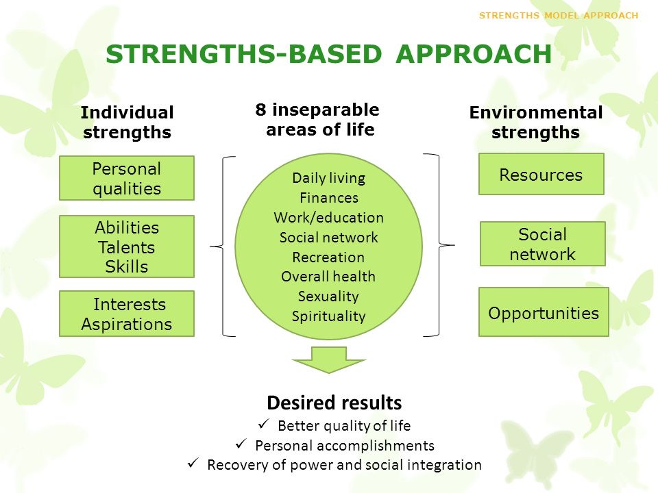
Strengths Based Approach
What matters to you?
Notes:
Chief Social Worker is moving towards Strength Bases Approach to underpin contextual safeguarding and Trauma Informed Care –
Person is unique
Person as an expert
Collaboration
Focus and language creates their reality
Authentic relationships built on their story
The Care Act 2014 requires local authorities to ‘consider the person’s own strengths and capabilities, and what support might be available from their wider support network or within the community to help’ in considering ‘what else other than the provision of care and support might assist the person in meeting the outcomes they want to achieve’. In order to do this the assessor ‘should lead to an approach that looks at a person’s life holistically, considering their needs in the context of their skills, ambitions, and priorities’.
Local authorities should identify the individual’s strengths – personal, community and social networks – and maximise those strengths to enable them to achieve their desired outcomes, thereby meeting their needs and improving or maintaining their wellbeing.
Any suggestion that support could be available from family and friends should be considered in the light of their appropriateness, willingness and ability to provide any additional support and the impact on them of doing so. This is also subject to the agreement of the adult or carer in question (see 6.64 of the Care Act guidance).
The implementation of a strengths-based approach within the care and support system requires cultural and organisational commitment beyond frontline practice. Practitioners will need time for research and familiarisation with community resources. Accountability has to be with the practitioner and time has to be allowed for the assessment to be undertaken appropriately and proportionately.
The objective of the strengths-based approach is to protect the individual’s independence, resilience, ability to make choices and wellbeing. Supporting the person’s strengths can help address needs (whether or not they are eligible) for support in a way that allows the person to lead, and be in control of, an ordinary and independent day-to-day life as much as possible. It may also help delay the development of further needs.
What is a strengths-based approach to care?
Strengths-based practice is a collaborative process between the person supported by services and those supporting them, allowing them to work together to determine an outcome that draws on the person’s strengths and assets.
What do practitioners need to consider?
Practitioners will need to work in collaboration with service users, supporting them to do things for themselves, with the aim that they become more than passive recipients of care and support. In order to do this, it is fundamental that practitioners establish and acknowledge the capacity, skills, knowledge, network and potential of both the individual and the local community.
Preparing for assessment
Preparing for an assessment is key to ensuring the intervention is conducted professionally, that its effects are maximised and that the assessment is both appropriate and proportionate. When preparing for an assessment you should:
• Gather information and background on the individual’s circumstances:
• What are their reasons for contacting social services?
• Are there any other professionals involved?
• Do the local authority or any partner organisations have any useful background information?
• Is an interpreter or advocate needed?
• Determine, jointly with the individual, how the assessment will be conducted in terms of appropriateness and proportionality.
• Has the individual been informed about what an assessment involves: their options, the timescales, the potential next steps?
• Does the individual prefer to perform a supported self-assessment? See the SCIE Guide, ‘Supported self-assessment’
• Agree on who should contribute to the assessment other than the individual and how this will be done.
A strengths-based approach to care, support and inclusion says let’s look first at what people can do with their skills and their resources and what can the people around them do in their relationships and their communities. People need to be seen as more than just their care needs – they need to be experts and in charge of their own lives.
PRC
Promise, possibility, positive expectations, potential
Resilience, reserves, resources, resourcefulness
Competence, capacities, courage
Survival, support, possibility, esteem, perspective, change questions
“What good is making someone safer if it merely makes them miserable”
- Lord Justice Mundy, What Price Dignity 2010.

Slide 22
What are the new NHS priorities?
Preventing domestic abuse
Tackling serious violence
Preventing perpetrators of child sexual abuse
Notes:
Confidential enquiry questions
Sharing data
NCA adolescent to parent abuse

Slide 23
Domestic abuse & violence during COVID
⬆ self-reporting honour-based abuse at antenatal appointments
⬆ MARAC referrals
⬆ reports and referrals to support helplines
⬆ reports of adolescent to parent violence
Data sharing, or lack of it …. again
Violence Reduction Units & Community Safety Partnerships
NHS providers will be refreshing existing DAV plans
Notes:
Confidential enquiry questions
Sharing data
NCA adolescent to parent abuse

Slide 24
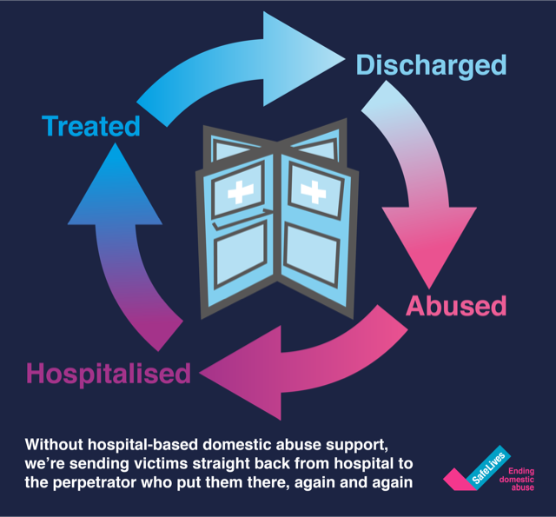
Domestic Abuse - stop the revolving door
All NHS providers must have a Domestic Abuse & Violence Policy with signposting victims & perpetrators to Independent Domestic Violence Advisory services.
Notes:
The Government’s Serious Violence Strategy, published in April 2018, represents a step change in the way we think and respond to serious violence, establishing a new balance between prevention and law enforcement.
The Strategy was published in response to increases in knife crime, gun crime and homicide across England.
Since the realisation that the increases we were seeing in serous violence were real there has been a keen interest to understand what has been done elsewhere to reduce violence in communities – this has led us to the phrase “public health approach” which is being used quite loosely with different interpretations by different organisations.
We need to use Contextual Safeguarding and Trauma Informed Practice to tackle exploitation and serious violence as these impact the same families.
From a violence prevention perspective the World Health Organisation provides a specific four step approach
This four step WHO model is underpinned by the following principles that a public health approach should be;
Focused on a defined population, often with a health risk in common.
With and for communities.
Not constrained by organisational or professional boundaries.
Focussed on generating long term as well as short term solutions.
Based on data and intelligence to identify the burden on the population, including any inequalities.
Rooted in evidence of effectiveness to tackle the problem
There are a number of different “Public Health Approaches” to tackling serious violence which have been in place for a number of years
The Cure Violence Approach and the Glasgow Violence Reduction Unit consider violence as a contagious infectious disease which spreads between people, reproducing itself and shifting group norms.
They propose that this explains why one locality might see more stabbings or shootings than another area with many of the same social problems.
Project CAPRICORN
Public Health Approach to Policing
West Midlands Violence Prevention Alliance
Supporting the creation of the Youth Endowment Fund
A member of the project team supporting Dame Carol Black’s landmark review of drugs commissioned by the Home Secretary in February 2019;
Supporting the Heroin and Crack Action Areas established in line with the serious violence strategy commitment;
A member of the national County Lines working group

Slide 25
Understanding the DAV perpetrator
“I slapped her once and I promised it would never happen again…but it did.”
We need to understanding the mindset and motivations of perpetrators if we are to prevent domestic abuse & violence
Respect Phoneline
0808 802 4040
Open Monday-Friday 9am-5pm. Free from landlines and mobile phones, your call will not appear on your phone bill statement

Slide 26

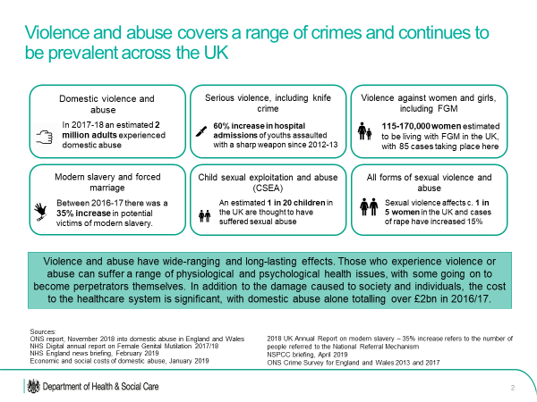
Tackling Exploitation & Serious Violence
Violence
Reduction
Units &
Community Safety Partnerships
Notes:
The Government’s Serious Violence Strategy, published in April 2018, represents a step change in the way we think and respond to serious violence, establishing a new balance between prevention and law enforcement.
The Strategy was published in response to increases in knife crime, gun crime and homicide across England.
Since the realisation that the increases we were seeing in serous violence were real there has been a keen interest to understand what has been done elsewhere to reduce violence in communities – this has led us to the phrase “public health approach” which is being used quite loosely with different interpretations by different organisations.
We need to use Contextual Safeguarding and Trauma Informed Practice to tackle exploitation and serious violence as these impact the same families.
From a violence prevention perspective the World Health Organisation provides a specific four step approach
This four step WHO model is underpinned by the following principles that a public health approach should be;
Focused on a defined population, often with a health risk in common.
With and for communities.
Not constrained by organisational or professional boundaries.
Focussed on generating long term as well as short term solutions.
Based on data and intelligence to identify the burden on the population, including any inequalities.
Rooted in evidence of effectiveness to tackle the problem
There are a number of different “Public Health Approaches” to tackling serious violence which have been in place for a number of years
The Cure Violence Approach and the Glasgow Violence Reduction Unit consider violence as a contagious infectious disease which spreads between people, reproducing itself and shifting group norms.
They propose that this explains why one locality might see more stabbings or shootings than another area with many of the same social problems.
Project CAPRICORN
Public Health Approach to Policing
West Midlands Violence Prevention Alliance
Supporting the creation of the Youth Endowment Fund
A member of the project team supporting Dame Carol Black’s landmark review of drugs commissioned by the Home Secretary in February 2019;
Supporting the Heroin and Crack Action Areas established in line with the serious violence strategy commitment;
A member of the national County Lines working group

Slide 27
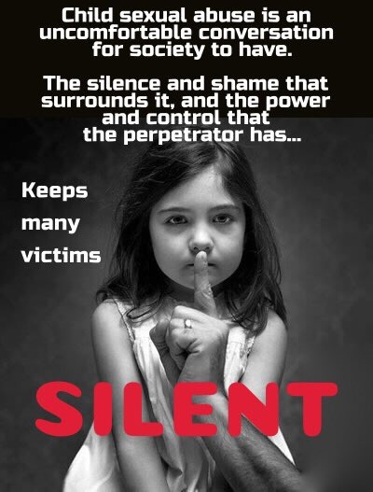
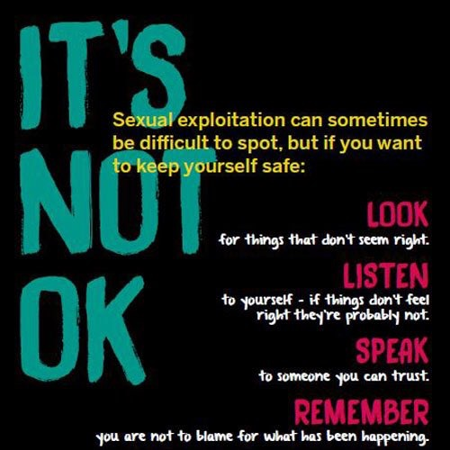
Child Sexual Exploitation & Abuse
It
is
never historic
Notes:
Child sexual abuse and exploitation is blending together into a new programme XGov programme of work.
We need to understand the voice of victims and survivors that this is never historic – adults of 80 can still recall the trauma of child sexual abuse at 8.
We are beginning to understand the mindset of perpetrators and this is sensitive – we must be ready to react to anyone who might be indicating signs of possible or probable child sexual abuse and act accordingly. Lucy Faithful Foundation can support.
Child sexual abuse and exploitation – this is a “national threat”
Partnership must include health
Abuse and exploitation – local interpretation
Hidden – social norms and unconscious bias
Do we need a national prevalence audit – so what?
We need consistent victim and perpetrator data fields
Neglect has risen, CSA has dropped ….. or has it?
CSA Centre https://www.csacentre.org.uk/subscribe-to-csa-centre-mailing-list/
Vicarious long term impact of parents and siblings who have to hear and read details.
Toolkits must not replace professional curiosity
Transitional safeguarding – CYP to adulthood cliff edge
Children and teenagers do not think the same about risk
IISCA – let’s talk to our children about sexual safety,
County Lines is not about drug dealers and gang masters ….. it is about child abuse which is impacted by supply & demand of drugs.
Contextual safeguarding – escalate place, space and school not just the person
Places (stairway or fast-food) often have a history.
Request a context conference and situation crime assessment. Set up active guardians.
Child sexual abuse on www – 100,000+ people looking in the UK at any one time,
Child House model
XGov - CSA + CSE; shift to contextual safeguarding & trauma informed practice;
Working Together 2018 – equal partnership is a work in progress for joint decision making.
Health and NHS need to profile Integrated Care Systems, Local Safeguarding Partnerships, Designated Professionals and data sharing agreements
We need all 1.6 million to be professionally curious.
Partnerships need to optimise Local Community Safeguarding Partnerships, Police & Crime Commissioners, Violence Reduction Units
SARC and SAAS – lifelong offer, data, commissioning model 2020,
National Helplines
Stop It Now 0808 1000 900 https://www.stopitnow.org.uk/
The National Association for People Abused in Childhood (NAPAC)
Call 0808 801 0331 free from all landlines and mobiles
Monday – Thursday 10:00-21:00 and Friday 10:00-18:00
NAPAC provides a national freephone support line for adults who have suffered any type of abuse in childhood.
Website: www.napac.org.uk
SurvivorsUK Helpline Web Chat
Web Chat
(Monday – Friday 10.30 – 21:00; Saturday – Sunday 10:00 – 18:00)
National Web Chat for adult male survivors of rape or sexual
Text: 020 3322 1860
Whatsapp: 07491 816 064
Website: www.survivorsuk.org
MOSAC (Mothers of Sexually Abused Children)
Freephone: 0800 980 1958
Supporting all non-abusing parents and carers whose children have been sexually abused. We provide various types of support services and information for parents, carers and professionals dealing with child sexual abuse.
Website: www.mosac.org.uk
SupportLine
Helpline: 01708 765200
Confidential emotional support to children, young adults and adults by telephone, email and post.
Website: www.supportline.org.uk
CISters (Surviving Rape and/or Sexual Abuse)
Telephone: 02380 338080
Answerphone 023 80 338080 is usually monitored daily during the week and callers can choose to leave their name and phone number, and we will call them back and will take care when doing so. Or can email admin@cisters.org.uk
The helpline is available to female adult survivors of childhood rape/sexual abuse, and others can call if they have a concern about such issues. In the case of the latter we will seek to signpost them to appropriate services.
PODS: Positive Outcomes for Dissociative Survivors
A project of Survivors Trauma and Abuse Recovery Trust (START)
Helpline: 0800 181 4420
PODS works to make recovery from dissociative disorders a reality through training, informing and supporting.
Tuesdays 6-8pm or appointments at other times by contacting the office
Email: mail@start-online.org.uk (for START) or info@pods-online.org.uk (for PODS)
Website: www.start-online.org.uk and www.pods-online.org.uk
Rape Crisis England and Wales
Freephone 0808 802 9999
12 noon – 2.30pm and 7 – 9.30pm every day of the year
Rape Crisis England & Wales is a feminist organisation that exists to promote the needs and rights of women and girls who have experienced sexual violence, to improve services to them and to work towards the elimination of sexual violence.
Website: www.rapecrisis.org.uk
Safeline
Male Helpline: 0808 800 5005
General Helpline: 0808 800 5008
Young people’s Helpline: 0808 800 5007
Text Helpline and Online Advisors: 07860 027573
Monday 10am – 4pm|Tuesday 8am – 8pm|Wednesday 10am – 4pm|Thursday 8am – 8pm|Friday 10am – 4pm|Saturday 10am – 12 noon
Safeline is a specialised charity working to prevent sexual abuse and to support those affected in their recovery.
Website: www.safeline.org.uk

Slide 28
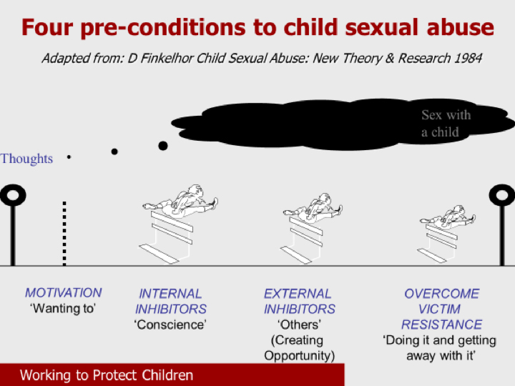
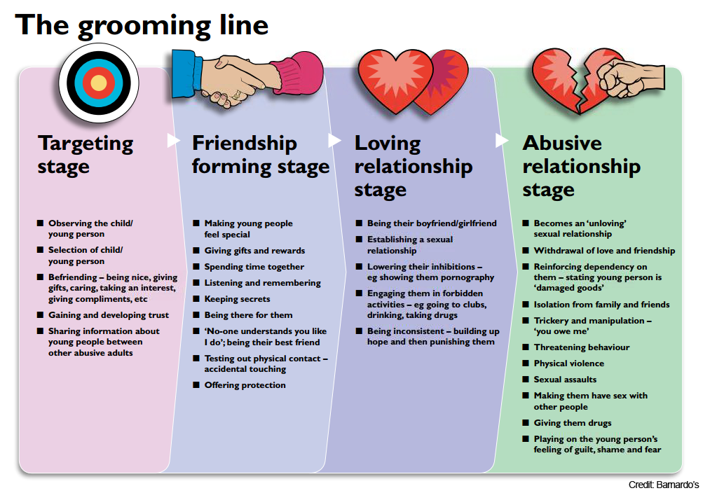
CSA – the perpetrator perspective
Stop It Now 0808 1000 900 https://www.stopitnow.org.uk/
Notes:
Understanding the perpetrator – Finkelhor 4 factor model and the grooming line

Slide 29

NHS Safeguarding & Data Sharing
All commissioned care organisations have a duty, if not contractual obligation, to share aggregated population data.
Every practitioner must seek informed consent to share their concerns.
If the client declines, the practitioner may still use clinical prerogative and choose to share for reasons of reasonable and lawful public safety or the client’s own health and well-being.
The practitioner must record their decision to share after client has decline in the patients record, as per Registration body & GDPR.
NHS Act 2006, Section 251
Every death & safeguarding review has recommend data sharing. No health staff have ever been found guilt of data sharing breach.
Notes:
I have lost count of the number of enquiries I get about whether organisations and practitioners should be sharing confidential data between themselves and with commissioners. Having read every regulation and protocol possible, here is my take on this issue.
There is no law or policy which inhibits legal data sharing, indeed every law states that secure data sharing is preferred attitude.
Section 251 exemption
There is a need to ensure that we have a legal basis respecting the common law duty of confidence. This is achieved by support under the Control of Patient Information Regulations (s. 251 support). As commissioners and system leaders we have s. 251 support to collect personal data from providers they commission. Commissioners routinely use this information to manage commissioning purposes and ensure that protocols are followed. NHS England has separate s. 251 support to receive the Assuring Transformation Dataset collected by NHS Digital from NHSE Regional and CCGs under directions.
The objectives of commissioner s251 support to receive the Assuring Transformation dataset are below:
ensure that all patients in funded care are known to the responsible commissioner and that reviews of their care have or will take place in line with principles of best practice;
support reporting to assure the public that effective action is being taken to address the wider failings identified;
iii. meet the safeguarding requirements suggested by patients, their families and advocates after the extensive consultation programme detailed in Section P
ensure that remedial action is taken to address areas of continued concern is taken.
complete the Assuring Transformation cycle of Enhanced Reporting enabling commissioners to oversee the work done by commissioners in ensuring patients care is managed and regularly reviewed. The data flow and data set within this application is a dataset which will allow commissioners to seek assurance about patients. This includes prompting commissioners to review patient care and monitoring the number of patients that met the criteria.
Any data request must indicate which of the above critique is been assured. The Person Identifiable Data may be shared lawfully provided:
The minimum necessary information is used
Only those with a need to know have access
Information is shared and stored securely and no longer than necessary
My own critique that some system leaders conflate data sharing child protection protocols with the need for collaborative contextual safeguarding across our partnerships.
Working Together to Safeguarding Children, 2018 states it is very clear about the duty to share information early and not just when a case is in child protection. Indeed these reforms offers a whole Chapter 4 to this important issue.
Practitioners should be proactive in sharing information as early as possible to help identify, assess and respond to risks or concerns about the safety and welfare of children, whether this is when problems are first emerging, or where a child is already known to local authority children’s social care (e.g. they are being supported as a child in need or have a child protection plan). Practitioners should be alert to sharing important information about any adults with whom that child has contact, which may impact the child’s safety or welfare.
It is also essential, as noted above information on third party adults with whom the child is in contact must also be shared and documented if it is considered they may pose a risk.
There is also the need to share aggregated information to identify trends e.g. Child Sexual Exploitation, County Lines and Prevent to name a few. By sharing aggregated data, we will be able to build prevention algorithms, such as happened with Adverse Childhood Experiences, after all most abuse follows a pattern.
Information sharing is also essential for the identification of patterns of behaviour when a child has gone missing, when multiple children appear associated to the same context or locations of risk, or in relation to children in the secure estate where there may be multiple local authorities involved in a child’s care. It will be for local safeguarding partners to consider how they will build positive relationships with other local areas to ensure that relevant information is shared in a timely and proportionate way.
Finally the fact the fear of sharing information must not be allowed to stand in the way. Fears about sharing information must not be allowed to stand in the way of the need to promote the welfare, and protect the safety, of children, which must always be the paramount concern. To ensure effective safeguarding arrangements:
All organisations and agencies should have arrangements in place that set out clearly the processes and the principles for sharing information.
The arrangement should cover how information will be shared within their own organisation/agency; and with others who may be involved in a child’s life.
I believe these statements make it absolutely clear that when a school nurse, health visitor, sexual health nurse becomes aware of information that may indicate a risk to that child, then this information should be shared if only to rule out any concerns. Repeatedly SCR’s still talk about the need to share information and within health itself there appears to be this fear that because organisations are commissioned separately then information cannot be shared across health services.
Finally, it is worth noting that the vast majority of death reviews have demonstrated the need for more expedient and secure data sharing between providers and practitioners.
My reflections ~
All commissioned care organisations have a duty, if not contractual obligation, to share aggregated population data
Every practitioner must seek informed consent to share their concerns.
o If the client declines, the practitioner may still choose to share for reasons of reasonable and lawful public safety or the client’s own health and well-being. This action should be taken under duty-of-candour.
o The practitioner should seek advice from the organisation SIRO.
o The practitioner must record their decision to share after client has decline in the patients record, as per Registration body; GMC guidance and GDPR.
Thanks for reading my reflections.

Slide 30
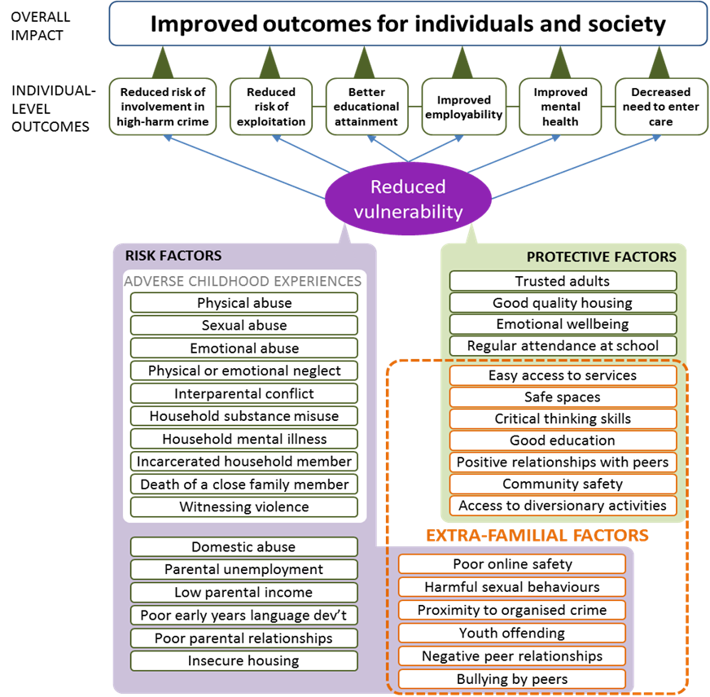
Intelligent targeted Interventions
Notes:
GDPR and DPA legal precedent to share

Slide 32

What can you do?
Be curious & ask the question
    What happened to you?
    How safe do you feel at home?
    What matters to you?
    How can we help make you thrive?
Avoid retraumatising
Find pragmatic solutions for disclosure
Create a social movement
Notes:
So what will you do after this event?
Our advise is to
Listen, Believe and Do Something
Be Curious – next time you see a bruise, ask the question
Avoid retraumatising
Find pragmatic solutions to people telling you about any abuse
Create a social movement – you cannot do this alone.

