Slide 1
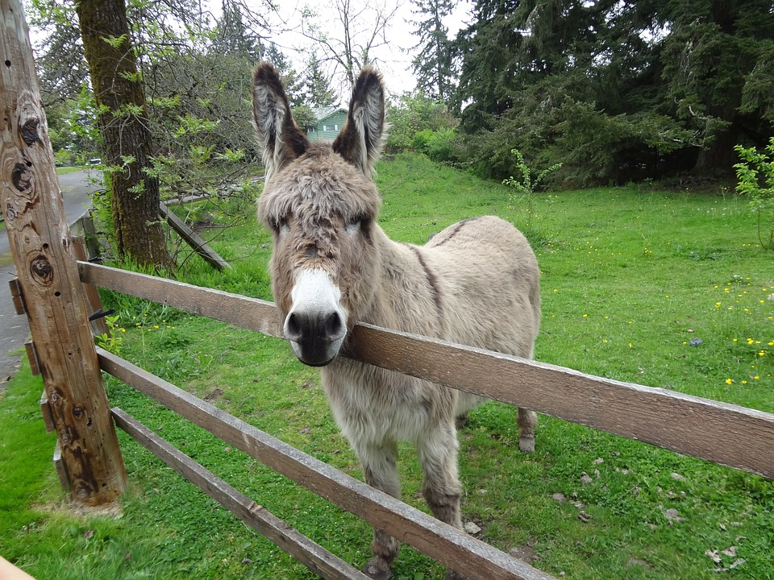
Making Connections Lisa Allen Specialist Community Public Health Nurse (School Nursing) and Specialist Nurse for Children in Care
@lukabaduka
This Photo by Unknown Author is licensed under CC BY-SA

Slide 2
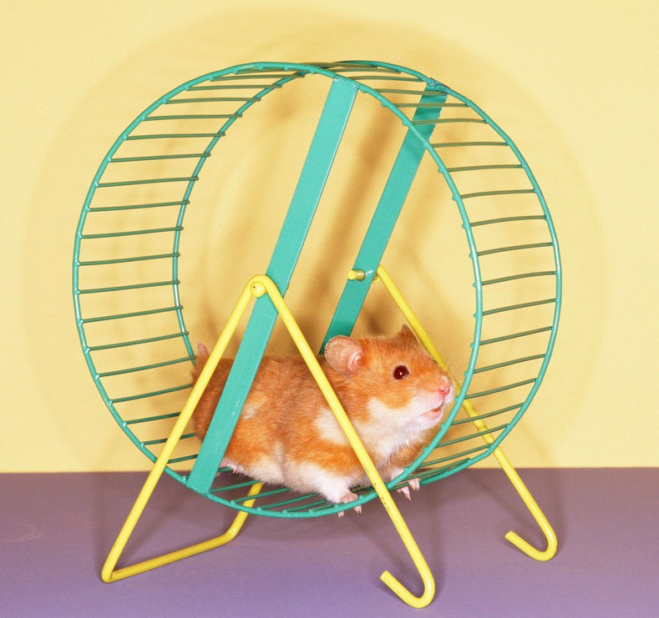
Pets…
Carr and Rocket (2017) researched children and young people in foster care. Results revealed:
In 88% of cases animals acted as a safe haven
• In 66% of cases animals acted as a secure base
• 88% of cases animals enhanced relations with foster carers
• 75% of cases animals acted as bridge to foster carers
Overall they found animals increase sense of safety and security
(Carr and Rocket, 2017 )

Slide 3
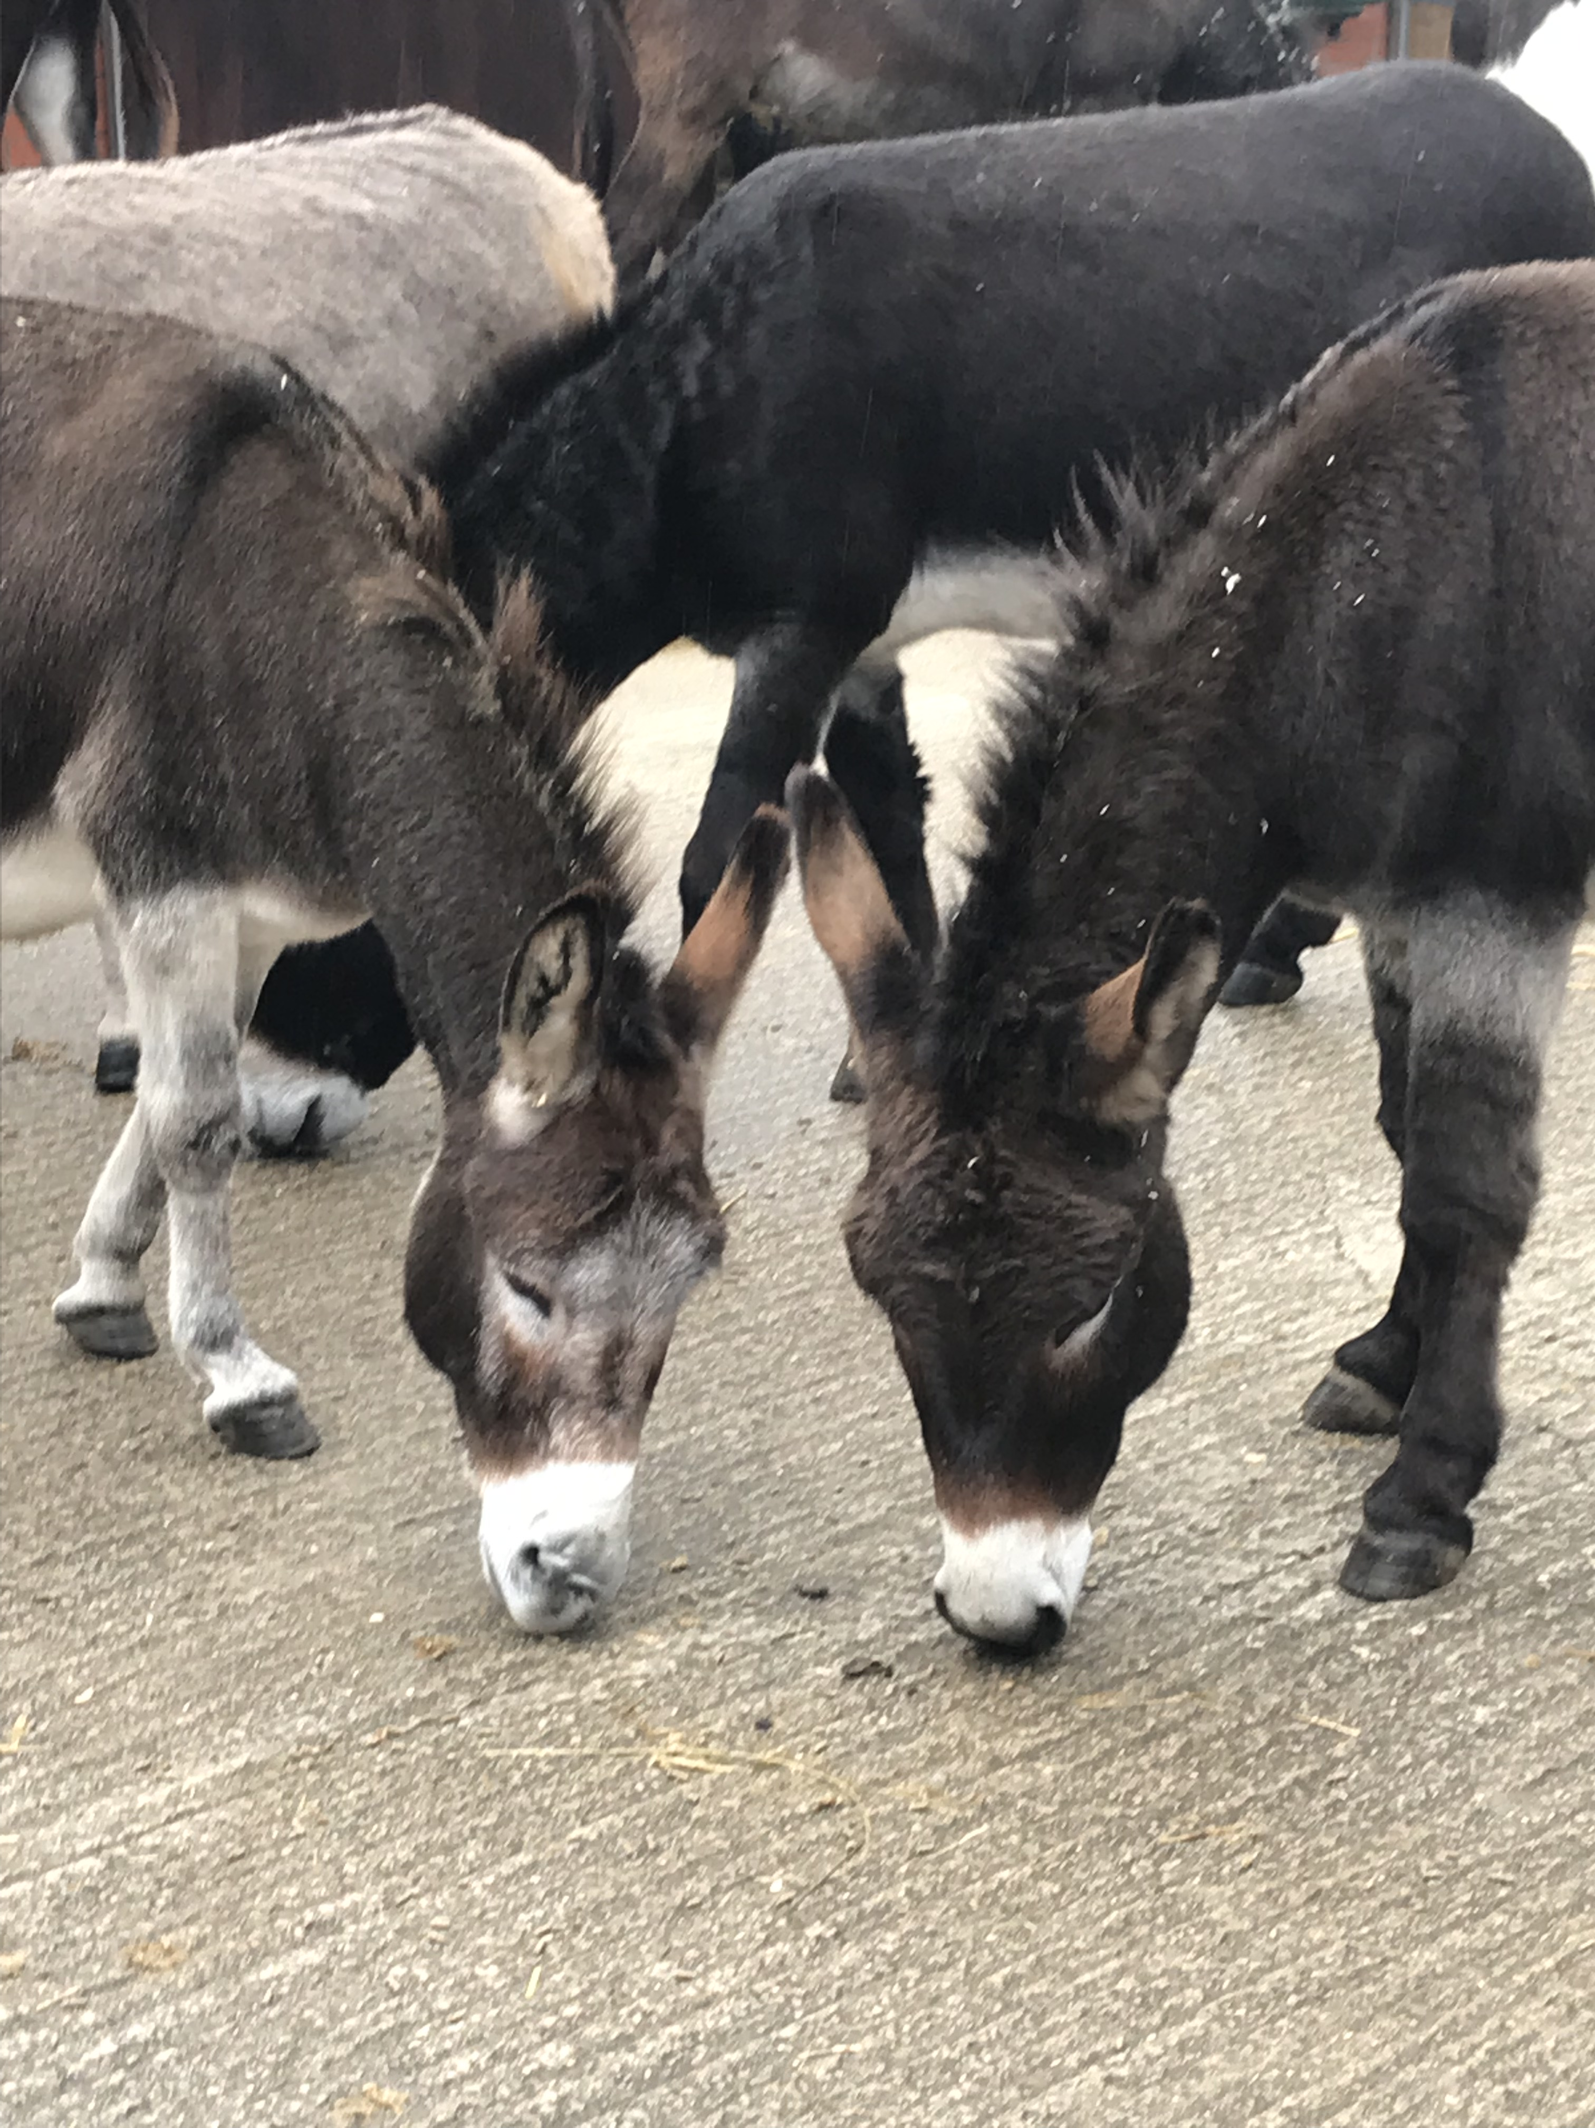
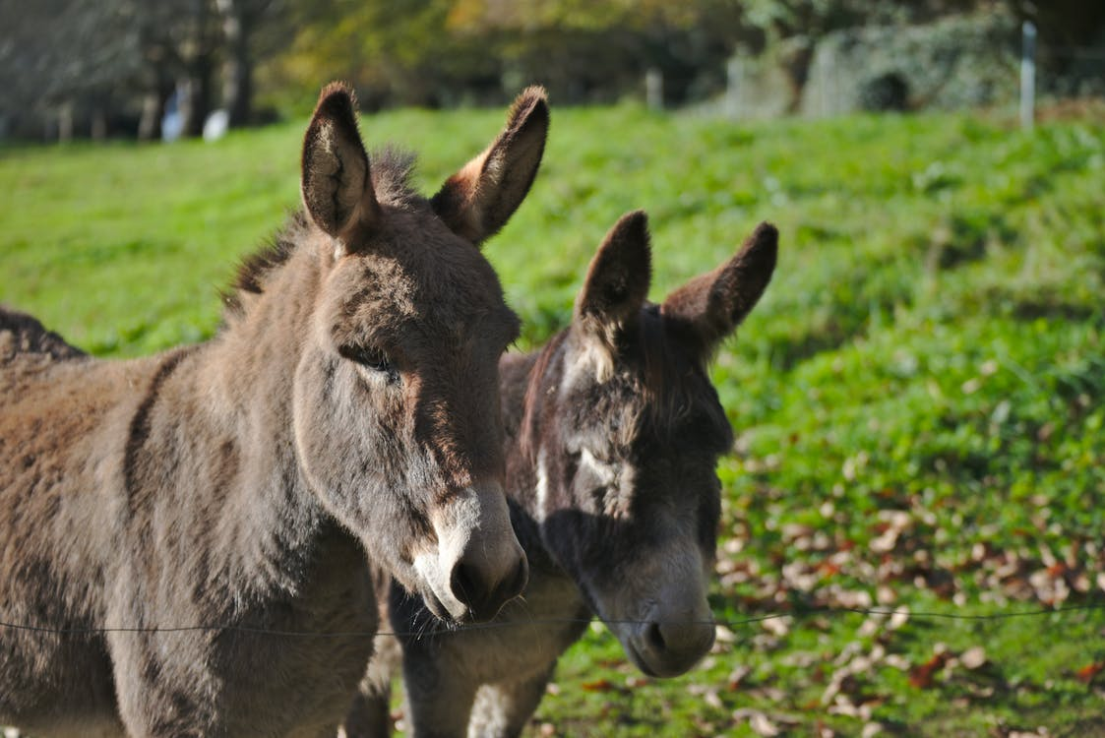
What young people have said: “When the donkey came over to me it made me feel so special” “I felt like if the donkey had arms he was actually hugging me” “I’m sure the donkey tried to help my anxiety, he made me feel so calm”

Slide 4
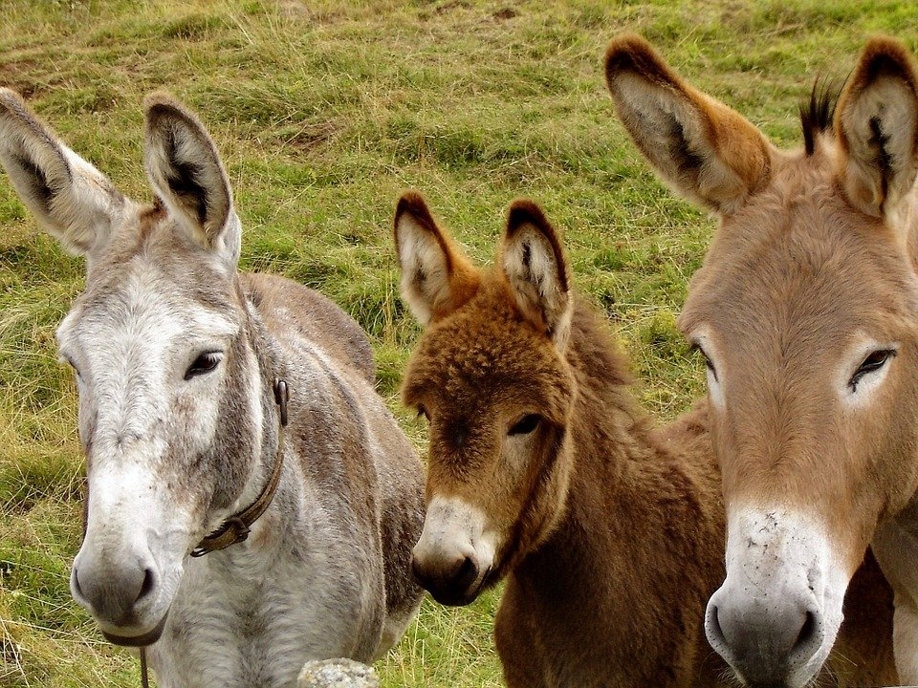
Connections
Understand
Listen
Reliable and trusted
Key competencies for all who work with children in care or with care experienced young people
(Royal College of Nursing, December 2020)

Slide 5
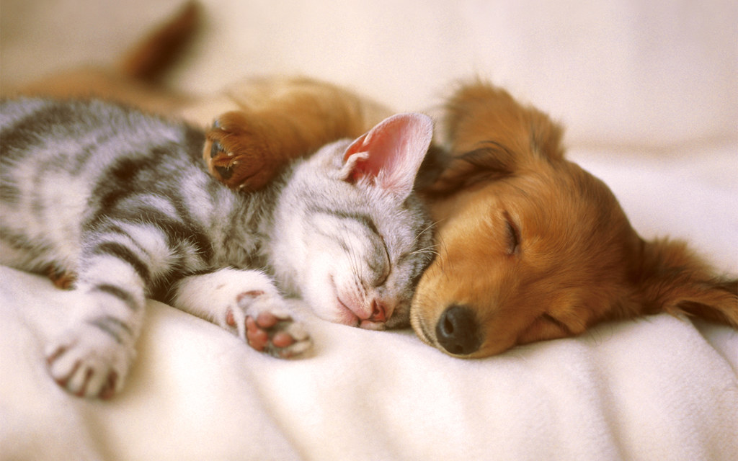
Thank you #thinkfamilyweek
#makingconnections

