Slide 1
Supporting and celebrating nurses working in independent settings with school aged children and young people
SHARON WHITE OBE
MSc (hons), RN, SCM, SCPHN (SN)
CEO SAPHNA
www.saphna.co

Slide 2
AGENDA
WELCOME AND INTRODUCTIONS
CELEBRATING GOOD PRACTICE; Kate Adams
SUPPORTING YOU TO SAFEGUARD
OPEN DISCUSSION/SHARING
HOW CAN SAPHNA SUPPORT YOU? www.saphna.co
NEXT STEPS?

Slide 3
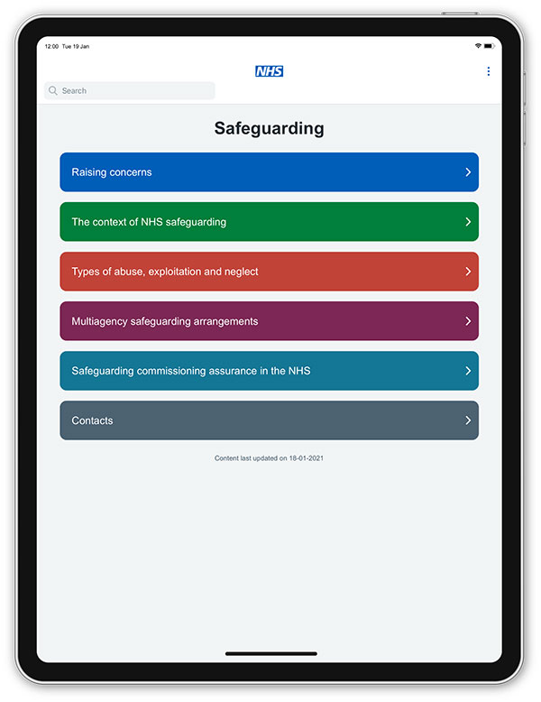
SAFEGUARDING
https://www.everyonesinvited.uk/
https://www.england.nhs.uk/safeguarding/nhs-england-safeguarding-app/
https://future.nhs.uk/
https://qrcoderesources.co.uk

