Slide 1
The UK Association of Directors of Public Health
www.adph.org.uk
Commissioning School nursing services fit for the future
Fit for the Future
October 22nd 2021
Jim McManus
DPH Hertfordshire , Interim President ADPH

Slide 2
The Big Lesson
Covid was not unprecedented if you look at History…nor will it be the last.
The multiple syndemic harms and impacts will cost us dearly
Build back fairer

Slide 3
Means Child Development becomes essential
“Build Back
Fairer”
https://www.adph.org.uk/covid-19/covid-19-resources/

Slide 4
The Key Challenge
Healthy, well-adjusted adults need a thorough-going joined up vision for child development and the services to deliver that, it is an economic imperative and we need the evidence to advocate for this

Slide 5
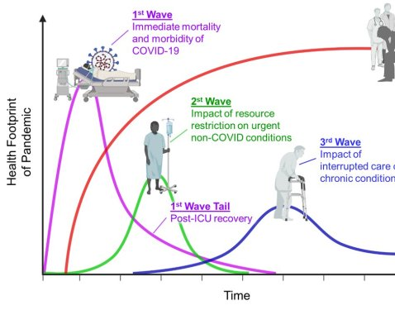
The long game of multiple syndemic impacts of Covid mean healthy child development is more and more crucial
Singer, 2009
1st Wave: Immediate mortality and morbidity of COVID-19.
1st Wave Tail: Post-ICU and admission recovery for many patients.
2nd Wave: Impact of resource restrictions on non-COVID conditions – all the usual urgent things that people need immediate treatment for – acute.
3rd Wave: The impact of interrupted care of chronic conditions (people stayed home).
4th Wave: Psychic trauma, mental illness, PTSD, economic injury, burnout, and more.

Slide 6
The Black Hole experience of national policy making
The closer you get the more reality and time get distorted
Speed and velocity become relative
Density increases hyper-exponentially
Everything gets sucked in
Light becomes scarce
What emerges is a new form of matter/energy. NOT necessarily a better one
We join up locally, because Government can’t

Slide 7
Where are we? 1
PREVENTION - £130bn on NHS £5bn on Public Health
Wanless predicted where we are today
Despite our claims to invest in prevention, the UK has emphasised clinical treatment and clinical services for illness at the expense of prevention for decades,
We have reaped the cost in the rise of preventable ill-health in our children and preventable disease in adults which creates a burden of ill-health much more costly in human, economic and public service terms than if we had invested in Prevention.

Slide 8
Where are we? 2
INEQUALITIES ARE WORSENING
this was true even before the Covid Pandemic, which arrived to find inequalities which predisposed our most vulnerable to worse outcomes than our least vulnerable.

Slide 9
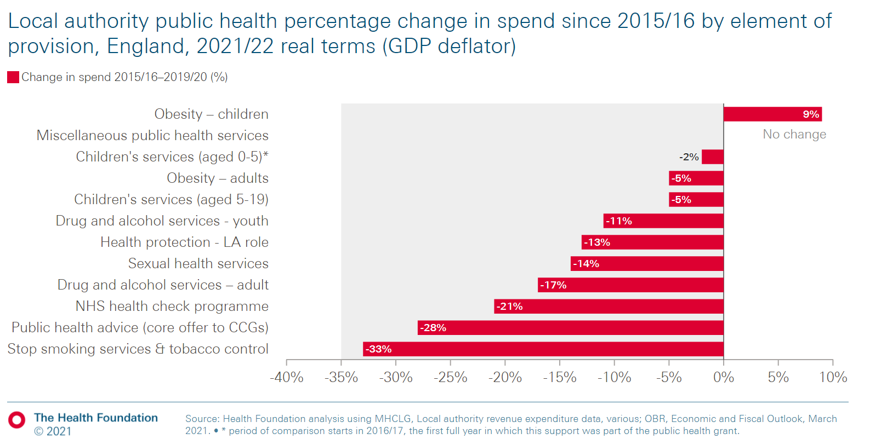
Where are we? 3

Slide 10
Where are we? 4
INVESTMENT –
We need more investment in public health services, and more investment specifically in child public health services.
economic analyses showing the cuts to public health have been a costly mistake
while we have rightly emphasised the importance of the first five years of life, public policy and professional practice has risked giving the impression of neglecting policy what were once called the “middle years” of Childhood, which are- evidentially – every bit as important as the Early Years.

Slide 11
Balanced scorecard slide 2
SO WHAT IS THE LEADERSHIP AGENDA?
I have based these on the Four Domains of Leadership developed for the Health Foundation by Ashridge Hult Business School
CONTEXTUAL : THE SYSTEM YOU’RE IN
PERSONAL: YOU PLC
Understand local government and the NHS, and how it works.
The soft as well as hard systems
power structures of getting things done
Self care plan
Leadership and influencing style
Finding time to do the important and the thinking as well as the urgent
Key Relationships: Some shift,some are enduring. Your exec member, CEO and peers and NHS CEO need to be key. Others may shift.
Build a “board of allies”
Fundamental Motivation
Keeping your skills up to date. Art as well as science. Having a ready reckoner of who leads on stuff
Legal, Media, Influencing and Quality Skills every bit as important as Science
INTERPERSONAL
TECHNICAL : SCIENCE AND ART

Slide 12
Key Leadership Tasks
An end to bad and siloed behaviour – we work together as a public health family and advocate with and for each other
No more seeking to argue within the cake, we have to get organised
Networks of influence where we orchestrate together to influence locally and nationally
Get persistent, insistent and consistent about what needs to happen on public health and why it is important for UK plc
New relationships – Health Foundation, NHS Confederation and more
Even more new relationships – Economists, Fiscal Experts

Slide 13
What is emerging from public health? the endgame is low not no covid
We cannot alter the virus. SARS-CoV-2 is extremely good at producing variants which are “fit” (very transmissibile)
Elimination – permanent reduction to zero not feasible right now
Eradication – effectively suppression to very low levels may be
Will need to reach this in stages – there is no other way
There is NO silver bullet, no single thing – an accumulation of small steps each of which is imperfect but add up in combination to prevent and suppress
So what does that look like? A staged and combination process. Clusters of disease. Measles-like?

Slide 14
Key Tasks and Context for Organisations
Learn to Live
Make your community, organisation and events covid safe
Learn to live with covid as a community
Confidence
Help people build confidence in managing risk
Articulate
Your organization’s capabilities and role in recovery across multiple impacts
Care and Connect
Help people grieve, make sense of what happened and be alert to mental health issues
Hope
Help people vision the next two years – i.e. life a year after the pandemic hopefully.

Slide 15
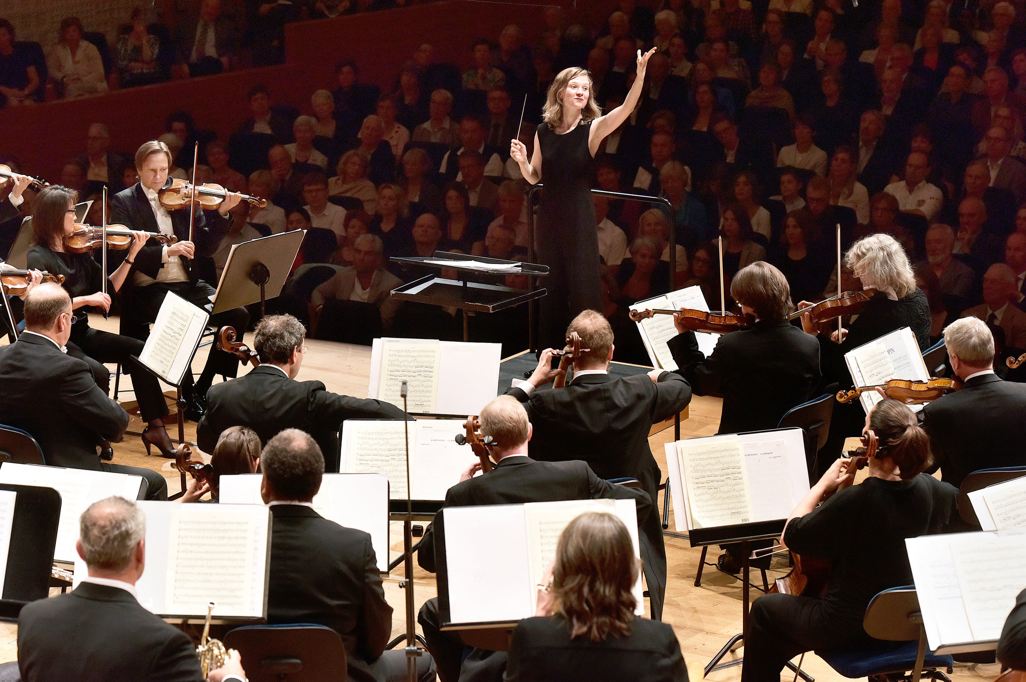
Orchestrated Leadership

