Slide 1
Cost of Living: Opportunities for action
A briefing
26 September 2022

Slide 2
Introduction
This briefing was originally intended for presentation at the South East Prevention and Health Inequalities Board, 19th September 2022.
Over the past several months inflation has had an impact on the incomes of households and businesses. While the UK Government is addressing cost of living pressures through fiscal and other measures, there are actions which Local Government, the NHS, the VCSE sector and their partners can take to mitigate against some of the negative pressures which may impact on people’s and communities’ health.
This briefing notes two helpful resources, the LGA’s Cost of Living Hub and the King’s Fund report The NHS’s role in tackling poverty. Awareness, action and advocacy with examples of relevant action. Additional actions are proposed drawn from available evidence. While there are numerous factors which influence health outcomes and these confound our ability to evidence the precise impact of interventions, evidence is sufficiently clear linking cold and poor diet with poor health outcomes.
It is hoped that these resources will support you in developing your local response to the cost of living pressures.

Slide 3
Content
Cost of Living: Opportunities for action | Slide
Inflation context | 4-8
Health and disparities | 9-15
NICE recommendations re cold homes and excess winter deaths | 16
Key actions – maximise access to entitlements | 17
Key actions – enhance actions for winter preparedness | 18
LGA Cost of Living Hub | 19-21
The NHS’s role in tackling poverty | 22-24
The rising cost of living: key facts, employer response and resources – NHS Employers | 25
Additional actions in the South East | 26

Slide 10
There are many potential impacts on people’s health
Increased rough sleeping
Worsening mental health
Reduced incomes
Increased rent arrears / mortgage defaulting
Increased homelessness
Increased overcrowding
Pressure on MH services
Increase in use of temporary accommodation
Increased damp
Increased suicide attempts
Pressure on UEC
Increased unemployment
Increased stress
Reduced ability to afford discretionary spend
Increased gambling
Medium and longer term increases in preventable ill health (obesity, smoking related illnesses etc)c
Longer term pressures on the health and care system
Increase in harmful drinking
Increased debt
Increase in drug use
Reduced household budgets
Reductions in physical activity
Increase in people working multiple jobs/ longer hours
Increase in unhealthy eating
People turning heating down
Increase in smoking rates
People struggling to cook & refrigerate food
Increase/ exacerbation of respiratory conditions
Increased fuel prices
People struggling to buy food
Increase in cold homes
People buying unhealthier/less nutritious food
Increase in CVD
Worsening diets
Increase in MSK
Inability to afford co-payment health services (e.g. prescriptions)
Increased food prices
People unable to travel to access health services
Worsening of preventable and treatable conditions
Pressure on primary care
Increased travel costs
People unable to travel to help dependents (e.g. elderly parents)

Slide 16
NICE recommended actions – cold homes and health risks
Shorter Term
Include health consequences of living in a cold home in the joint strategic needs assessment process
Identify those especially at risk from cold homes – both on the basis of health and socioeconomic factors
Create a single-point-of-contact health and housing referral service for vulnerable people living in cold homes to provide tailored, personal advice (inc. energy efficiency improvements, benefit advice, priority service registration, advice on avoiding cold home health risks, short-term crisis support)
Assess heating needs of people using primary health and home care services and non-health and care workers who visit people at home
Discharge vulnerable people to a warm home
Raise awareness amongst practitioners/public about how to keep warm at home
Longer Term
Train health and social care workers to help people whose homes may be too cold
Train housing professionals/faith and voluntary sector workers to help people whose homes may be too cold
Train heating engineers, meter installers and insulation providers to help vulnerable people at home
Ensure buildings meet ventilation and other building/trading standards
NICE guideline: Excess winter deaths and illness and the health risks associated with cold homes – Up to date as of August 2019

Slide 17
Key actions - maximise access to entitlements
Is capacity available to enable this? e.g., through funded support to the VCSE?
Consider flexible use of personal budgets and direct payments in the adult social care.
Consider flexible use of personal health budgets
Promote guidance on getting an extra payment to help with the cost of living if entitled to certain benefits or tax credits – low income, disability, pensioner - Cost of Living Payment
Promote access to Free Schools Meals and Healthy Start
Notes:
PHB - The point they are making here is that the PHB is not ‘new money’ it is simply vehicle for agreeing and providing payment to an individual. The criteria for how the PHB is used would need to be agreed by the person funding the PHB. So for the Right to Have PHB’s (Continuing Health Care, S117 and Wheelchair budgets) – it would be the individual ICB decision. For other smaller PHB’s – it would depend on where the money was coming from.
In the forums – the main debate is around the increasing cost of electricity for those with an existing PHB who have health equipment that requires electricity to run. A lot of the debate is around whether the PHB should be increased to reflect the increase costs of running the equipment.
The Direct Payment Regulations are, by intention, none restrictive. This is to enable systems NHS and Social Care to develop plans on an individual basis.
guid-dirct-paymnt.pdf (england.nhs.uk)
There are some exceptions, which I’ve include below.
3.2 Services that direct payments cannot be used for
22)Direct payments for healthcare will not be appropriate for all aspects of NHS care an individual may need.
23)A direct payment cannot be used to purchase primary medical services provided by GPs, as part of their primary medical services contractual terms and conditions20 nor is a direct payment suitable for the following public health services:
• vaccination or immunisation, including population-wide immunisation programmes.
• screening,
• the national child measurement programme
• NHS Health Checks
24) A direct payment cannot be used for urgent or emergency treatment services, such as unplanned in-patient admissions to hospital or accident and emergency. This is because by their very nature they are unplanned and so will not have been included in a care plan. Whilst CCGs should not include services which require unplanned emergency access they may want to develop advance directives or crisis planning to ensure that people’s wishes are taken into account when a crisis happens or that they have increased support or services to prevent the need for emergency care or hospital admission.
25) A direct payment cannot be used for surgical procedures. Individuals can choose which hospital they are referred to and they should be involved in discussions and decisions about the tests, treatment and management, but a direct payment cannot be used to pay for them.
26) A direct payment cannot be used to pay for any NHS charges, such as prescription or dental charges.
27) A direct payment cannot be used;
• to purchase alcohol or tobacco,
• for gambling,
• to repay a debt (with the exception of debts relating to services specified in the care plan).
In addition they can not be used to purchase anything illegal or unlawful.
There is provision to enable additional costs incurred as a result of the agreed care plan, to be covered within the PHB, e.g. milage or running costs.
However, this would need to be quantified.
As with all these things, it is for the ICB/ICS to determine, in line with their agreed policies.
Also, to what extent is this an integrated budget between Health and Social Care?

Slide 18
Key actions – enhance actions for Winter preparedness
Ensure that Winter plans are ready and actionable
Use General Practice registers to maximise flu vax and COVID booster uptake – all eligible Source: NHSE
Reach non-responders, underrepresented and underserved – building upon successful innovation demonstrated with COVID vaccine work with communities.
Discharge planning checks for warm home and healthy food before discharge Source: NICE
Enable Social Prescribing Link Workers to support people to avoid hospital admission, support discharge and high intensity users/ frequent attenders Source: Angel Osei-Fosu. Broadcast. NHS Platform
Frontline staff undertake practical checks for vulnerable in their homes – health visitors, care workers, fire and rescue services Source: NICE

Slide 19
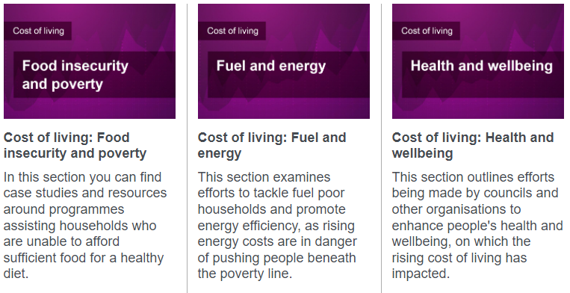
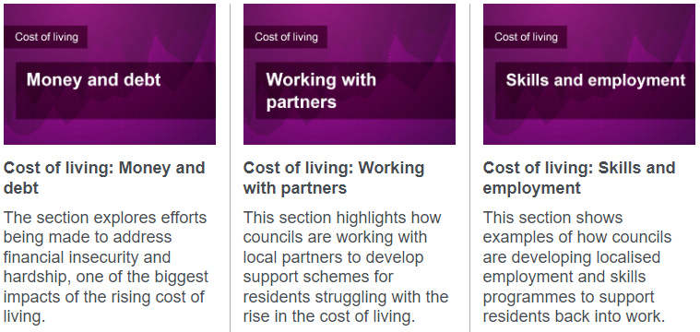
LGA Cost of Living Hub
This hub has been designed to share best practice and help councils to support their residents with the rise in the cost of living. Case studies and resources can be found for each topic area in the pages below.

Slide 20
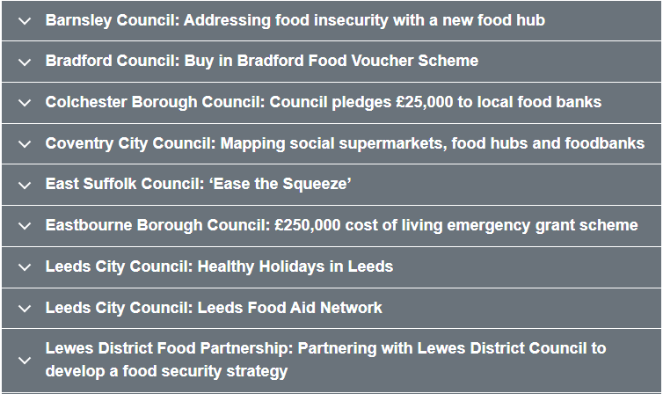
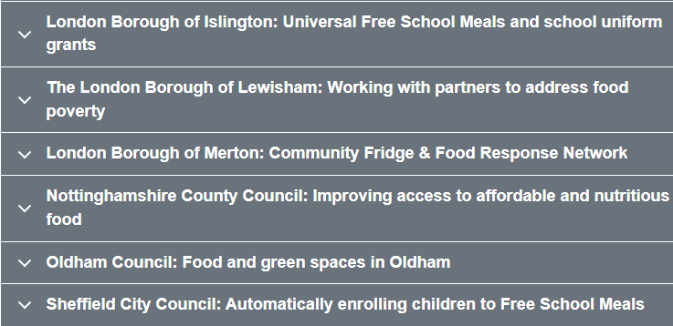
Cost of living: Food insecurity and poverty

Slide 21
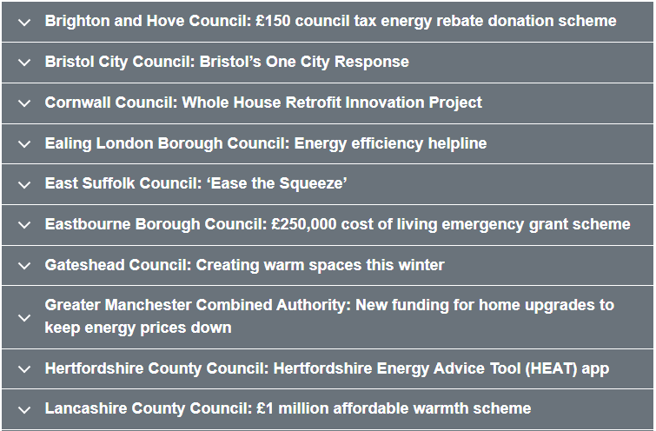
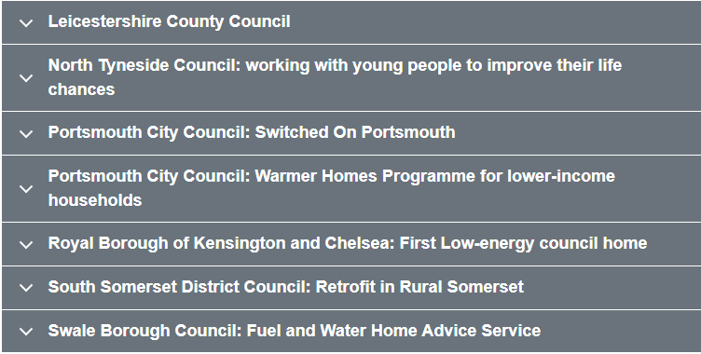
Cost of living: Fuel and energy

Slide 22
The NHS’s role in tackling poverty. Awareness, action and advocacy
Awareness raising:
Raising awareness re poverty is the cornerstone for action
Enhancing engagement with people who experience poverty, understanding what poverty means for them, their health, and how they use and access the NHS + coproduction
e.g., truth commission (Morecambe) fairness commission (Islington)
Awareness training
Re who is impacted and how poverty impacts on health; personal decision-making and how to engage and adapt NHS services; intersectionality; opportunities to influence across life-course; resource support; impact of stigma; staff who also experience poverty.
Access to the right data and analysis e.g.’ use of PHM data to match needs of those in poverty with pre-emptive interventions and help improve how care is delivered across pathways.

Slide 23
The NHS’s role in tackling poverty. Awareness, action and advocacy
Practical actions:
Actions as a service provider: meaningful engagement and co-production with people with lived experience of poverty; paying attention to inequalities as digital innovations roll out; making use of social prescribing and stronger integration between social welfare and health services; and measuring meaningful outcomes and spreading good practice.
As an economic and social partner in place: use status as anchor organisations in communities to tackle poverty. E.g. on procurement, comply to the letter and with spirit of the Social Value Act; use economic levers, including focus on fiscal multiplier effect across all local economies.
Its role as a good employer: with a particular focus on support around accommodation and a new national platform from the Recognition and Reward Team - FutureNHS Collaboration Platform
Source: The NHS’s role in tackling poverty. Awareness, action and advocacy. The King’s Fund. March 2021.

Slide 24
The NHS’s role in tackling poverty. Awareness, action and advocacy
Advocacy:
Has a unique position and authority,
held in high public regard; use voice and reputation to influence and speak up and out for people and communities at risk of or experiencing poverty.
Clinicians also require support from non-clinical leaders to ensure they feel safe to speak out about poverty without fear of negative consequences.
NHS Trust staff hardship funds
Source: The NHS’s role in tackling poverty. Awareness, action and advocacy. The King’s Fund. March 2021.

Slide 25
The rising cost of living: key facts, employer response and resources

Slide 26
Additional actions in South East
Mapping of supportive actions mitigating impacts of cost of living within Local Authorities
Collate local practice examples on accessible platform using LGA Cost of Living hub structure and similar functionality
Cost of living webinar – Friday 7th October 2022, 9-10.30am: hosted by OHID, with NHSE SE and SE Association of Directors of Public Health
Brief overview of cost of living impacts
Highlighting impactful actions for Winter and beyond
Share examples of practice – South East
Outline plans/ options to host accessible practice examples in the South East
To request a registration link for the Webinar, please contact the OHID Business Support Team: OHIDSEBST@dhsc.gov.uk

