Slide 1


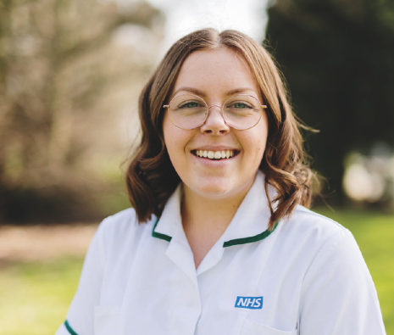
The Preceptorship Academy
Post-Registration (School and Public Health Nurses)
The Practice Education Team
August 2023

Slide 2

Humber Teaching NHS Foundation Trust
Multi-Professional Preceptorship Academy
The trust has been awarded the National Preceptorship for Nursing Quality Mark. This is a recognition of the quality of Preceptorship for Nursing in an organisation and the trust was one of the first 17 in the country to achieve it.
Notes:
Piece of feedback for your revalidation/ re-registration.

Slide 3


National Framework Update

Slide 4
Purpose of Preceptorship
"to provide support, guidance and development for all newly registered practitioners to build confidence and develop further competence as they transition from student to autonomous professional". National Preceptorship Framework (2022)

Slide 5

What does Preceptorship mean to staff?

Slide 6
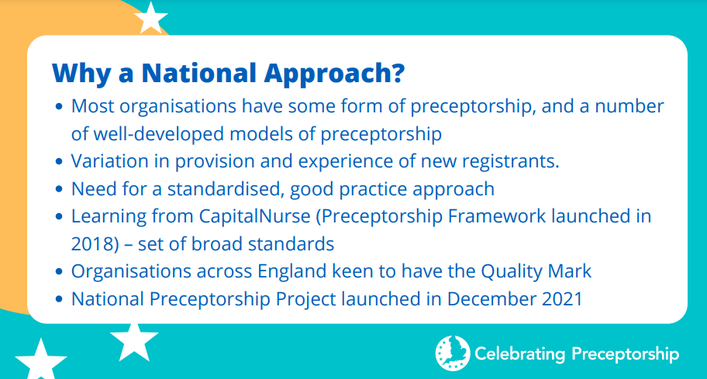
National Framework Update

Slide 7
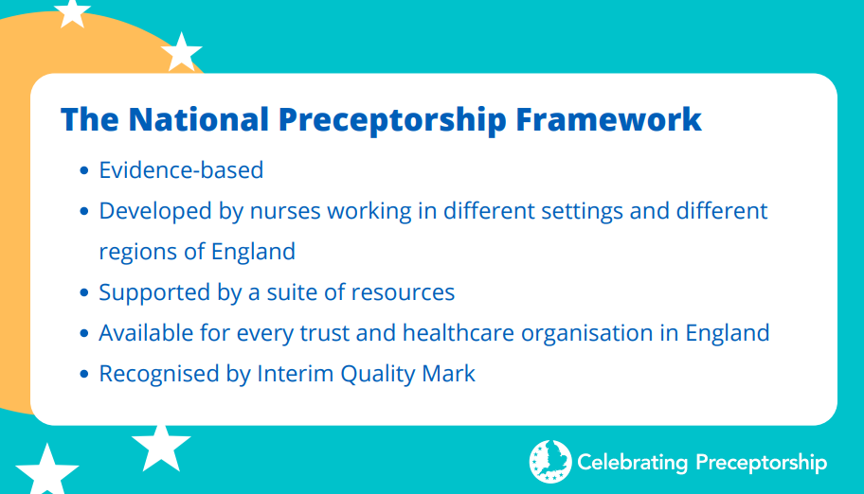
What is the National Preceptorship Framework?

Slide 8
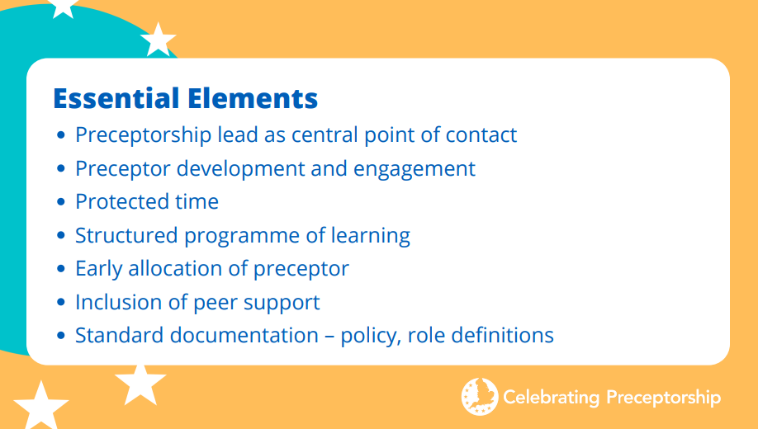
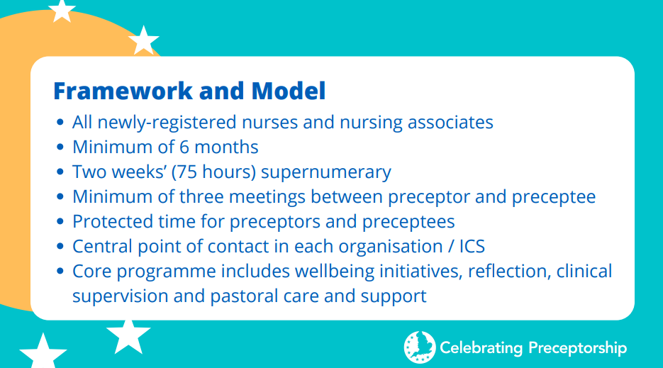
How does Humber align to the National Preceptorship Framework?

Slide 9
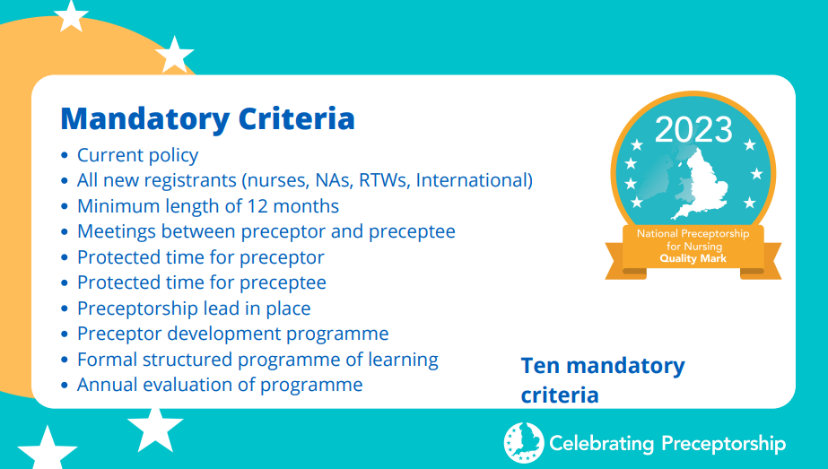
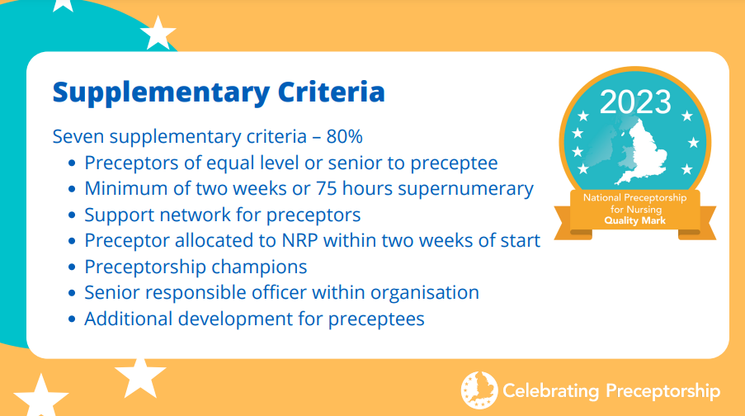
Why was Humber awarded the Interim Quality Mark?

Slide 10

Humber Offer (Overseas Nurses and Post-Reg)
Professional Development Guide
This document is built upon the CapitalNurse programme documentation and can be used to supplement the Preceptorship Academy Handbook
The Preceptorship Academy aim is to guide and support participants to continue their lifelong learning by empowering professionals to celebrate their strengths and identify areas for development.
The Preceptorship Academy can offer access to training and learning opportunities that will further enhance and compliment knowledge and skills as a registered nurse.
All staff will be allocated a clinical supervisor within their team, who will also be made aware of the available training opportunities through the Preceptorship Academy.
The attendance at these will be agreed through collaboration and support from your supervisor and documented in your Employee Appraisal.

Slide 12
Preceptee Population
NEWLY QUALIFIED STAFF (ALL DISCIPLINES)
INTERNATIONALLY EDUCATED NURSES
RETURNING TO PROFESSIONAL PRACTICE
RETURNING FROM LONG-TERM ABSENCE (MATERNITY ETC)
POST-REGISTRATION PROGRAMMES (HV/DN/SN/NMP)
Notes:
Working on the newly qualified NMP package with Liz.

Slide 13
Calendar 23-24
Month | Activity/ Task | Other
September 2023 | Preceptorship Week 1 (Blended Timetable) 2nd October – 6th October | Opportunity of having a PNA 1:1 from a series of pre-boked dates
October 2023 | 30th October - Action Learning Set 1 – Lecture Theatre
November 2023
December 2023 | 8th December - Review point 1 – Lecture Theatre
January 2024
February 2024 | 16th February - Action Learning Set 2 –(Closed Cultures and Compassion) Lecture Theatre
March 2024 | 28th March – Review Point 2 – Lecture Theatre
April 2024 |  | Spring School 18th March-22nd March
May 2024 | 20th May – Action Learning Set 3 – Lecture Theatre | Preceptorship Week
June 2024 | 25th June – Review Point 3 – Lecture Theatre
July 2024 |  | Summer School 8th July – 12th July
August 2024 | 12th August – Action Learning Set 4 – Lecture Theatre
September 2024 | 9th September - Final review point – Lecture Theatre

Slide 14
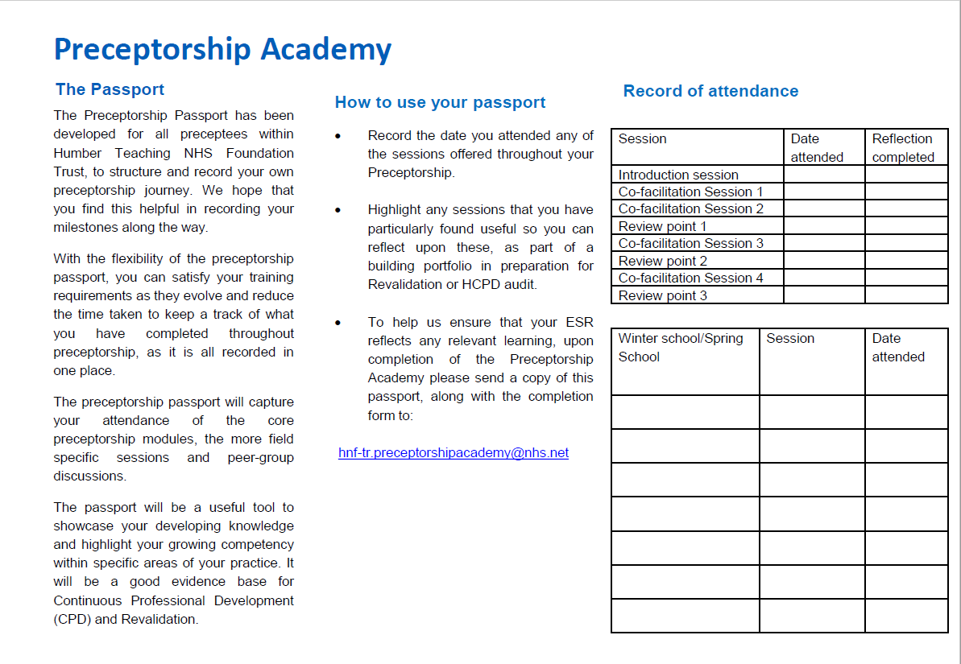
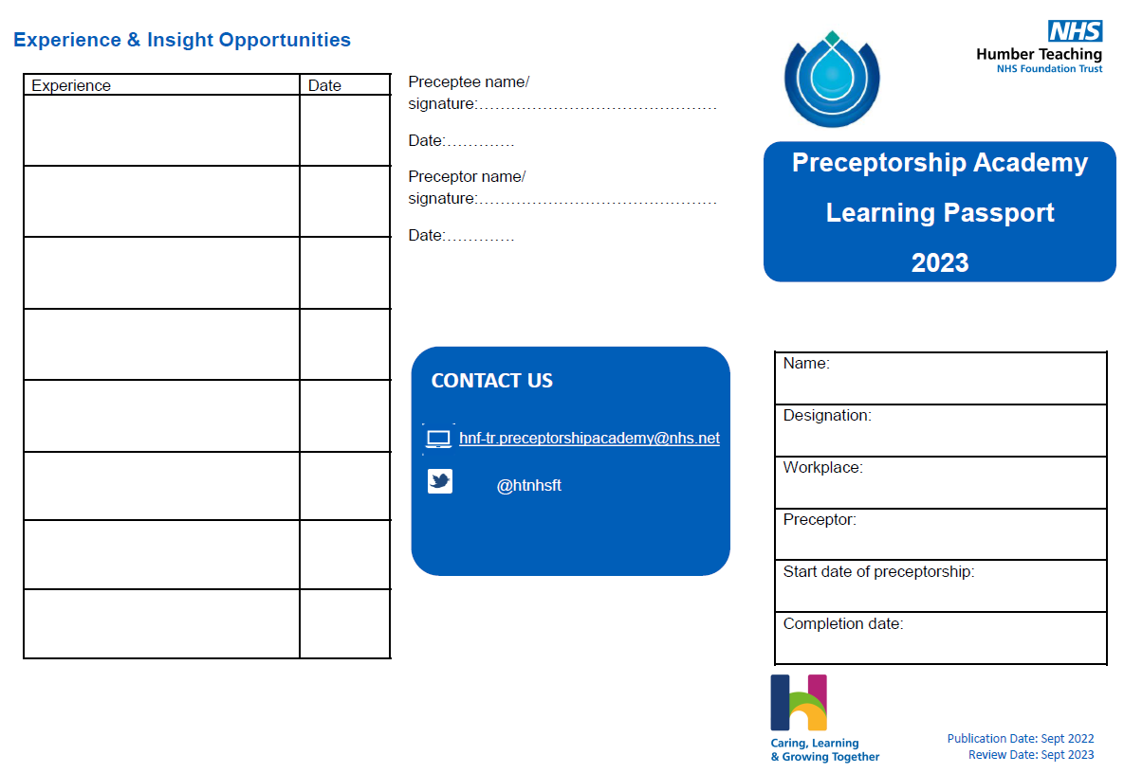
Passport

Slide 15
Support
Peer group reflection
Preceptor support in-house
Preceptorship Academy team support
Monthly drop-in
Review points
Duty inbox

Slide 16


Action Learning Sets
Reflective activities whereby the preceptees can work together to problem solve specific work/ development problem or issue working through the following stages:
  Deconstructing the problem/ dilemma
  Getting to ‘the root’
  Gain deeper understanding
  Providing suggestions and advice
  Develop an action plan
  Re-group and report back at the next session
  https://www.youtube.com/watch?v=tNUIgG4T7RQ

Slide 17
Competencies
Role Specific Competencies:
Role Specific Clinical Competencies (humber.nhs.uk)

Slide 18
Competencies (Preceptorship)
Currently 10 activities to work through in the core handbook
Locally developed competencies
Professional body competencies (OT and SLT etc)
Informed by job description

Slide 19
What the future has in store…
Working towards AHP national preceptorship
Inclusion of social work and non-medical prescribing

Slide 20
Any questions?

Slide 21
The Humber Preceptorship Academy Resources and Contacts
Video - Humber Teaching NHS Foundation Trust Preceptorship Academy – YouTube
Queries re: Preceptorship duty inbox address - hnf-tr.preceptorshipacademy@nhs.net
Preceptorship Lead (Humber) – Melanie Barnard - melanie.barnard@nhs.net
National Preceptorship Framework Resources - NHS England National preceptorship programme 2022 - National Workforce Skills Development Unit

