Slide 1
Study skills (from my experience too)
Level 6 and 7 study
Progression into specialist practitioner, with more focus on applying knowledge and adding own judgements based on the information on a topic
“more critical”
Writing critical means to evaluate evidence from more than one perspective and pulling these together in your work to form your own conclusions
Reading tips
Skimming articles for relevance and scan for the specific information
Make notes as you read and analyse details of the evidence process whilst reading – using a critical analysis tool can help with research papers
Utilizing own expertise and experience
Believe in your own ability and skills you already have, challenge evidence and current practices

Slide 2
Top tips!!
Planning is KEY
Talking to academic supervisors early if any problems arise
Try to always maintain focus on the end goal
Utilise university resources whenever possible
Stay connected to family and friends
Utilise national peer support networks – SAPHNA for any support with projects/research
Last but not least - Self care is a priority!

Slide 3
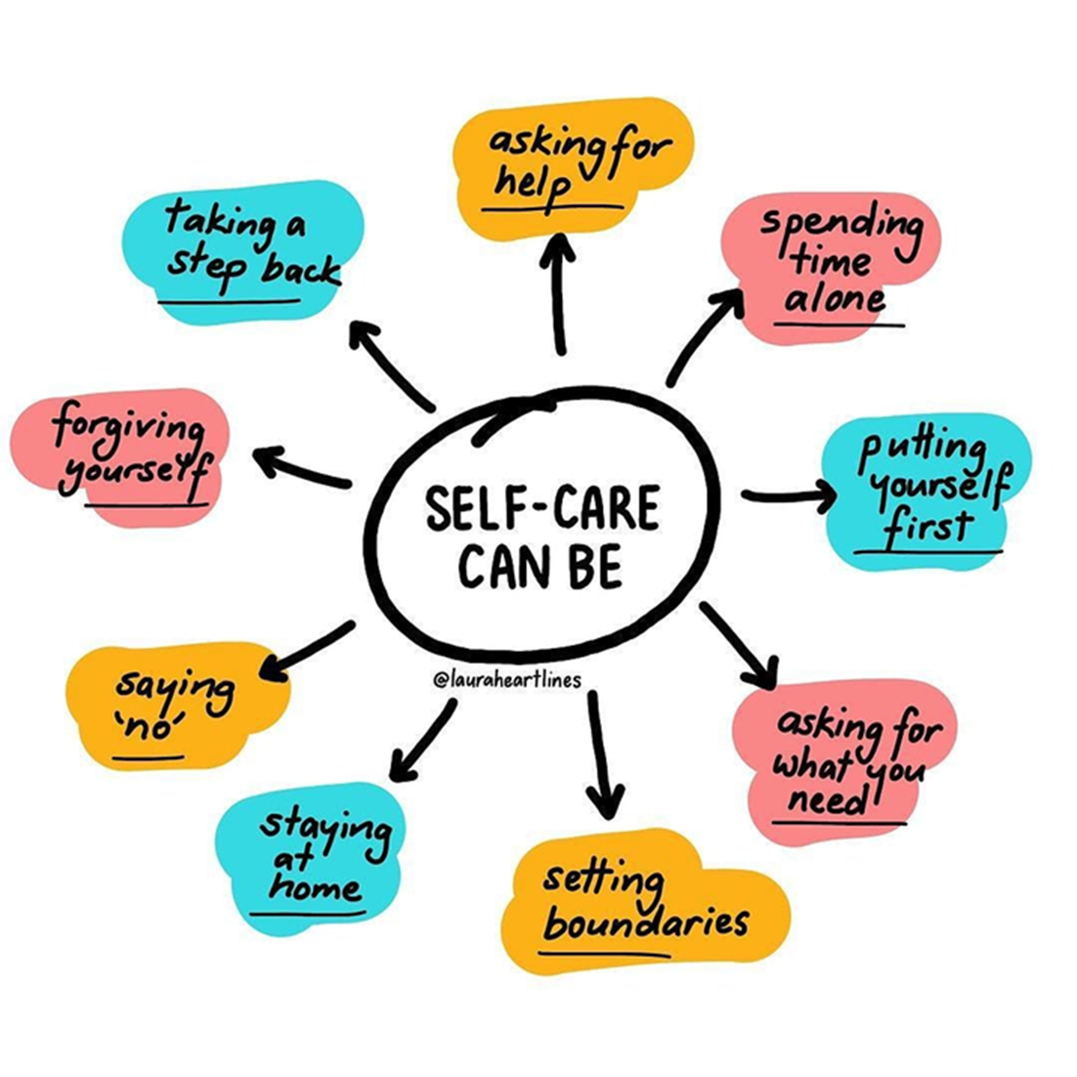
Self care can be any of these

Slide 4
