Slide 1
Independent School Nurses
NHSmail rollout project
Presented by: Gabby Rice, Project Manager, NHSmail Centre of Excellence
Notes:
Standard title slide

Slide 2
Anticipated benefits
What is the rollout project?
Access to O365 license which allows you to access the Microsoft suite of collaboration tools:
Core: Windows, Powerpoint, Excel, Outlook (including Global Address book)
MS Teams
MS Bookings, Viva Engage, Viva Insights, Breakthru etc
License attached to user (multiple devices) as an ISN – if you change roles outside of ISN you will no longer have this license
Increased visibility/access to other NHS colleagues e.g. GPs/hospital staff
Improvement in safeguarding due to more efficient communication/not being 'out of the loop'
Access to wider comms from National Organisations e.g. O365 messages
Access to training through Microsoft and other communities e.g. Digital Heroes
Notes:
Plain slide with subhead and bullets

Slide 3
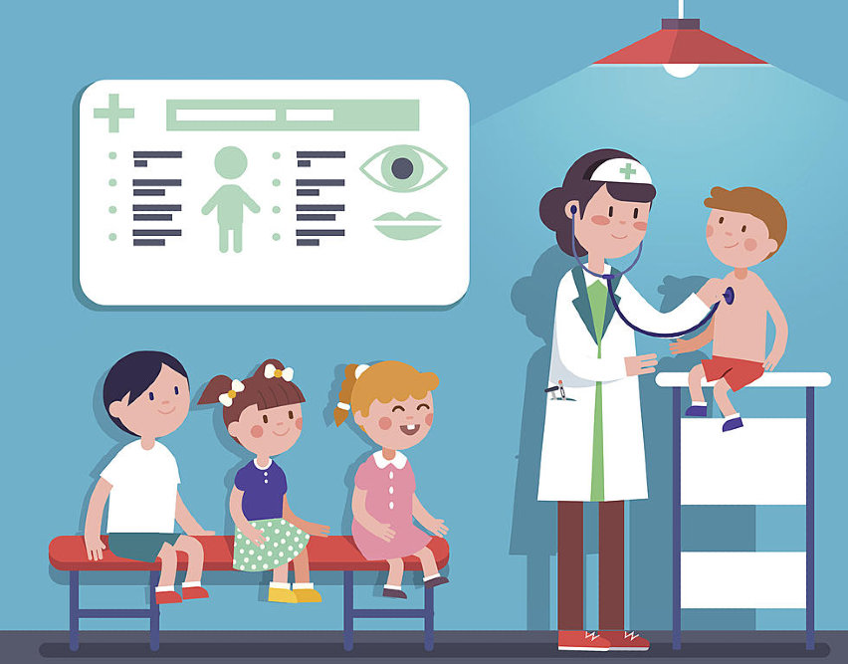
Who is eligible?
Nurses working in an independent school setting (e.g. day school/college, special needs education, independent boarding school, regulatory areas)
State school nurses are unfortunately ineligible at this time – future rollouts planned
Must have valid NMC number for verification
Must be working in England
Notes:
Plain slide with subhead and bullets

Slide 4
Process
ISN wishes to apply for a O365 license
>
Application form (MS Forms)
>
Verification stage – batch confirmation check by NMC
100 applicants required
>
Account provided by National Administration Service
Notes:
Plain slide with subhead and bullets

Slide 5
Timelines
Expected rollout by the end of 2023
Speed of rollout determined by how many applicants we get – batch confirmation processing
Best route would be to apply now, as soon as we have enough applicants we can begin providing the licenses
https://forms.office.com/e/XrWpcV57qi
Notes:
Plain slide with subhead and bullets

Slide 6
Notes:
Connect with us

