Slide 1



Evidenced Based Preventative Care to Children & Young People with SEND
Presenters – Kath Lancaster (The Lancaster Model)
&
Zoe Fish (Whole School Health Lead, Kent)

Slide 2
“The governments vision for children and young people with special educational needs and disabilities (SEND), is the same as for all children and young people (Department for Education & Department of Health 2020), supporting the delivery of a core programme of evidenced based preventative healthcare”.

Slide 3

Failure to deliver regular universal assessments to ALL children and young people and meet individual health needs stores up problems for the future

Slide 4
Reinforces a core programme of regular assessments for ALL, based on preventative healthcare, with additional care and support for those who need it.

Slide 5
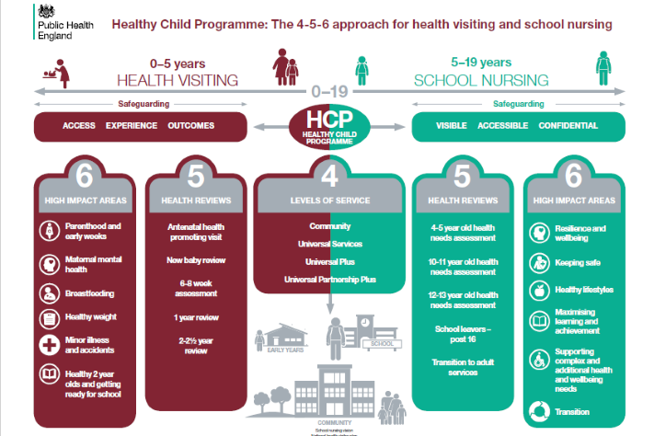
Emphasises a core programme of regular assessments, insisting that ALL children and young people receive the full-service offer (Healthy Child Programme)

Slide 6
“The Lancaster Model”

Slide 7

Why The Lancaster Model?
Developed over 25 Years and Recommended by DH
Provides a National, Validated, Universal Needs Assessment Approach
Focuses on Early Indicators, Early Intervention and Prevention
Uncovers Problems Earlier before they Escalate
Provides a Platform to Hear the “Voice of the Child/Young Person”
Ensures Individuals have the Opportunity to Ask for Help & Support & Access Information immediately
Delivered Online via an innovative, secure Portal & Platform
Provides Aggregated Data Reports to evidence the bespoke design of preventative public health practice

Slide 8
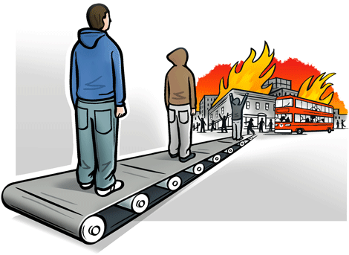

Slide 9
“The Partnership”

Slide 10

Method
TLM In partnership with Kent Community NHS Foundation Trust
Initial proposal in October 2021
Submitted a proposal plan
Commenced collaborative pilot in November 2021

Slide 11
“The Collaborative Pilot”

Slide 12
Action Plan
Scoping/mapping of current SEND Schools and Units
Established a group of TLM /SEND Experts, who could advise, motivate and support the change process
Produced a marketing strategy to support the new SEND Model
Categorised levels of SEND to support development of TLM Questionnaires

Slide 13
SEND Categories (Three Levels)
Level One (Pilot A) - Pupils who could complete the existing TLM Questionnaires with additional support and help
Level Two (Pilot B)- Pupils who could complete an amended/simplified TLM Questionnaire with help and support
Level Three (Pilot C) - Pupils who required a completely different approach for TLM data collection

Slide 14
SEND Classifications (Level One)
Based on the Education, Health & Care (EHC) Assessment)
Social Issues (withdrawn or isolated)
Emotional Issues (displaying challenging disruptive or disturbing behaviour)
Mental Health Difficulties (ADHD or attachment disorder)

Slide 15
SEND Classifications (Level Two)
Based on the Education, Health & Care (EHC) Assessment)
Social Issues, Emotional Issues, Mental Health Difficulties
Communication and Interaction (Asperger's syndrome and Autism)
Speech and Language (difficulty saying what they want to and understanding what is being said to them)
Physical and Sensory (require additional ongoing support and equipment)

Slide 16
SEND Classifications (Level Three)
Based on the Education, Health & Care (EHC) Assessment)
Social Issues, Emotional Issues, Mental Health Difficulties
Communication and Interaction
Speech and Language
Physical and Sensory
Cognition and Learning (Severe Profound and multiple learning difficulties)
Notes:
.

Slide 17
Pilot A
Involved 90-100 participants/pupils
Most participants were able to complete Existing TLM Questionnaire/Process
Although extra support from school staff was required during data collection
School Nursing staff also provided support to identified pupils
Findings – Level One pupils were able to complete the existing mainstream TLM approach with extra support and guidance

Slide 18
Pilot B
Involved 20-25 participants/pupils
Collaborated with a school who had both Level One & level Two pupils, to develop an amended/simplified version
The topics were broken down into smaller, bite sized sections, due to limited attention span of pupils
Further explanation/hints were also attached to certain words
Increased colour and animation was added
Findings– Level Two pupils were able to complete an amended version of TLM, returning to complete over a period of time

Slide 19
Pilot C
Involved 6 -7 participants/staff
Collaborated with a school with level Three pupils
Lesson plans and teacher guidance instead of questionnaires were developed inline with the SEND national curriculum
The process involved school staff collecting individual pupil information using the lesson plans, teacher guidance, hints, explanations and their existing knowledge.
Familiar symbols were also utilised to help answer the questions
Findings – The process was a success. The best possible way to collect the data was proposed to be at each pupils Education Health Care Plan annual review. Next the data will be inputted by school health admin.

Slide 20
“Practice Outcomes”

Slide 21
Pilot 1 - What Went Well?
Marketing and engagement with schools
All pupils were happy to complete the questionnaires with additional support
Access to information requests increased

Slide 22
Pilot 1 - What Were the Challenges?
Some pupils needed further explanation for certain words and directions
Increased staff capacity is required to complete a session and meet the need, which may be a problem in the future
Finding relevant, appropriate Information links because these are quite limited

Slide 23
Pilot 2 - What Went Well?
Increased positive profile for school nursing teams
Made links with schools who had not had a previous service
Improved partnership working with other professionals and services
Opened channels of communication between pupils, school staff and school nursing teams

Slide 24
Pilot 2 - What Were the Challenges?
School staff did not really understand the data collection process, further marketing required
Safety/safeguarding issues increased which had to be dealt with quickly
Travelling to school appeared an issue for a high number of pupils, therefore further capacity was required to meet this priority need immediately

Slide 25
Pilot 3 - What Went Well?
Increased engagement with schools who had not previously accessed public health services
The Education Health Care Plan (EHCP) was predominantly education focused, so this was an opportunity to holistically consider health related impact too
The wider holistic information will now be used to improve transition to adult services

Slide 26
Pilot 3 - What Were the Challenges?
School staff having the additional time to complete the process
School nursing staff being reliant on the data collection by school staff in a timely manner
School nursing staff being able to support any public health work, due to limited SEND resources currently available

Slide 27
“Case Studies”

Slide 28

Individual Needs

Slide 29
Case Study – 1 – Child C
Incomplete questionnaire submitted by year 6 pupil, but comments indicated support required for emotional health.
Young person stated ‘I need help’ but little other context. Support wanted re. safety concerns at home and school, bullying, friendships and emotional health.
At drop in session, “C” shared that her dad had died, but that she still ‘sees’ him and appeared unsure if he is dead or alive.
Class teacher shared retrospectively that they had not been aware for many months that the “C’s” father had died. She had moved to England from Nigeria and she was unsure if “C “ had additional learning needs as she had ‘never taught a child like “C” before’.

Slide 30
Case Study – 2 – Child A
“A” (Year 10) attended a drop-in session with school nurses as her questionnaire alerted us to safeguarding and emotional health concerns. “A” disclosed at this time that home life was difficult and shared that there were 10 people living at home in a 3-bed house.
“A” shared that father occasionally smokes cannabis and drinks alcohol regularly. It was shared that fathers’ moods become very volatile when intoxicated.
It was shared that “A” had previously self-harmed and struggles significantly with her emotional health. It was also shared that mothers’ partner who currently lives in Bulgaria, made a sexual comment towards “A” via facetime.

Slide 31
Case Study – 3 – Individual Child J and Whole Class
Child “J” discussed with class teacher concerns about disability and family illness. Child “J” has selective mutism, frequent seizures and significant learning needs, alongside family disability/ill health concerns.
Following conversation re. any help and support required for child “J”, we discussed some other concerns that had arisen from bespoke school report – primarily regarding the number of children flagging up with a family member with a disability or long standing illness.
Out of a cohort of 28 children, 9 children were living with a parent with a significant physical health/mental health condition, including 4 children whose parent had been diagnosed with cancer and one with a brain aneurysm.

Slide 32
“Public Health Data”

Slide 33
Population Needs

Slide 34
Aggregated Data
Level One and Level Two Pupils
KEY
RED (Above Kent Mainstream Average)
AMBER (Same as Kent Mainstream Average)
GREEN (Below Kent Mainstream Average)

Slide 35
Safety
Questions | SEND | Mainstream
Have you been to A&E following an accident or injury in the past 12 months? | Yes (11%) | Yes (23%)
Have you been admitted to hospital following an accident of injury in the past 12 months? | Yes (17%) | Yes (14%)
Pupils with worries and concerns about their Safety | (11%) | (5%)
Where were pupil’s safety concerns | At Home – (50%) In School – (25%) Near Home – (25%) | At Home – (6%) In School – (10%) Near Home – (3%)

Slide 36
Bullying
Questions | SEND | Mainstream
Have you ever been bullied? | Yes (78%) | Yes (43%)
What sort of bullying have you experienced? | Physical - (44%) Verbal - (33%) Social - (11%) Cyber - (11%) | Physical - (2%) Verbal - (7%) Social - (5%) Cyber - (2%)
Do you know anyone who has been bullied? | Yes (39%) | Yes (23%)

Slide 37
Emotional Health & Wellbeing
Questions | SEND | Mainstream
Do you usually feel cheerful and happy? | No (17%) | No (28%)
Do you usually feel calm and relaxed? | No (39%) | No (37%)
Do you usually look forward to your day ahead? | No (17%) | No (43%)
Do you ever feel anxious, worried, stressed or in low mood? | Yes (50%) | Yes (77%)

Slide 38
Internet Safety and Gaming
Questions | SEND | Mainstream
How much screen time do you have every day? | Over 8 Hours (17%) 5 to 8 Hours (33%) | Over 8 Hours (16%) 5 to 8 Hours (27%)
Do you participate in online gaming? | Yes (72%) | Yes (56%)
How many hours a day do you spend gaming? | Over 8 Hours (11%) 5 to 8 Hours (17%) 2 to 5 Hours (28%) | Over 8 Hours (1%) 5 to 8 Hours (3%) 2 to 5 Hours (13%)
How many people in your class do you think participate in online gaming? | All (33%) Most (44%) | All (14%) Most (40%)

Slide 39
Worries and Concerns
Questions | SEND | Mainstream
Health & Wellbeing Safety Bullying Emotional Health & Wellbeing Diet Weight Physical Activity | (33%) (11%) (11%) (17%) (17%) (11%) (0%) | (12%) (5%) (5%) (11%) (6%) (21%) (3%)

Slide 40
Worries and Concerns
Questions | SEND | Mainstream
Alcohol Smoking Drugs Solvents Sexual Health Internet Safety | (11%) (11%) (6%) (6%) (6%) (0%) | (2%) (5%) (3%) (3%) (3%) (1%)

Slide 41


Slide 42
Share The Evidence
Positive feedback from School Staff and Head Teachers, who welcomed the process and the data sharing
Positivity from school nursing staff, as it enabled them to evidence and direct the appropriate support and help
Individual staff nurses who had previous experience with SEND, felt this proactive new approach improved both their role and their service outcomes

Slide 43
The Future/Next Steps
Further Marketing using the data from the pilots
Influence our stakeholders surrounding what a “Good” ECHP looks like
Increase our access to appropriate SEND resources and information
Share the Public Health Priorities with Commissioners and other stakeholders
Full roll out in 2025 across Kent inline with mainstream pupils

Slide 44
“SEND children and young people are an incredibly varied group, they come from different communities, are growing up in different circumstances and have a very diverse set of need”. (Dame Rachel de Souza, Children’s Commission 2022)
We are proud to now be able to fully support these unique individual’s and ensure they have their needs assessed regardless of their Special Educational Needs and Disabilities.

Slide 45
“Any Questions?”
For further information:
Website - www.thelancastermodel.co.uk
Email: kath@tlmhapi.co.uk

